Slide 1
Apprenticeship Data
A video recording of this webinar is available at https://youtu.be/Zg6pfVf-gbg.

Slide 2


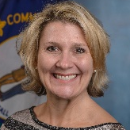


Apprenticeship Data
April 19, 2021
Tracy Korsmo
North Dakota Information Technology Department
Todd Willnow
North Dakota Information Technology Department
Scott Secamiglio
Kentucky Center for Statistics
Jessica Cunningham
Kentucky Center for Statistics
Ryan Murphy
Iowa Workforce Development
Jeff Sellers
SLDS State Support Team

Slide 3
Session Overview
Welcome and Introductions
State Panel Perspective
Q & A
Wrap Up

Slide 4
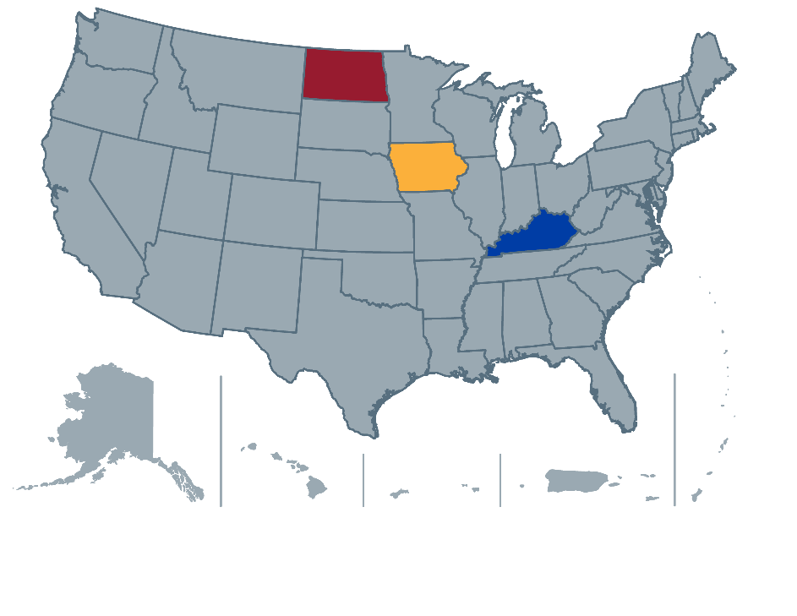
State Panel Perspective
Tracy Korsmo and Todd Willnow, North Dakota Information Technology Department
Scott Secamiglio and Jessica Cunningham, Kentucky Center for Statistics
Ryan Murphy, Iowa Workforce Development

Slide 5
New and Expanding Apprenticeships in North Dakota
Tracy Korsmo
Enterprise IT Architect
tkorsmo@nd.gov
Todd Willnow
Programmer Analyst III
twillnow@nd.gov

Slide 6
Why?
Want to grow the number of apprentices enrolled in programs
Want to start creating nontraditional apprenticeships programs
Need to continue on-the-job training after graduation
Financial burden to an individual in obtaining a 4-year degree

Slide 7
Who?
  Department of Commerce
    Has a grant to “create new or expand existing registered apprenticeships in North Dakota, with a goal enrollment of 315 participants”
  North Dakota Career and Technical Education (CTE)
    Has a grant to develop new apprenticeships in technologically advanced careers and support integration of federally registered apprenticeships into workforce development, education, and economic development strategies for North Dakota business and industry. The state apprenticeship expansion grant includes developing nontraditional apprenticeships and includes partnering with higher education (community colleges for instruction) and improving the collection, integrity, and sharing of workforce data.
  Job Service
    Qualified participants in WIOA-funded programs

Slide 8
How?
Extract data from DOL RAPIDS system
Number of new programs, number of new programs in new industries, and number of new participants (approximately 8 new programs and 8 new industries)
  Align new programs with established academic degrees
  Industries asking for apprenticeship resulting in an academic certificate aligned to the specific job
  An evaluation of prior recognized certificates as replacement for class credit
  Up to 1,000 hours of prior work experience may be awarded
Identify new apprentices in industries that may not qualify for WIOA funding but may qualify for grant funding
  Urgent as a WIOA qualification may be a barrier

Slide 9
History
North Dakota has had traditional apprenticeship programs.
Increasing apprenticeship participation has been difficult in the past. Community college and traditional union apprenticeship programs in the service, construction, and manufacturing industries have yielded low representation of minorities, veterans, and women.
We have not tried to create apprenticeship programs outside of the traditional trade programs.

Slide 10
Forward-Looking Plans
Increase apprenticeship program diversity into STEM, careers, and professions
Increase apprenticeship diversity in individuals (i.e., women, veterans, and underrepresented cultural and ethnicity groups)
Establish pre-apprenticeships at the high school level
Market and educate individuals to research apprenticeship programs as alternatives to the traditional education-to-workforce path
Use comprehensive data management

Slide 11
How Will This Fit in With the SLDS?
Goal of having a statewide view of all apprenticeship programs
Articulating through exploration the apprenticeships available by community
Promoting pre-apprenticeships and internships to secondary students
CTE pathway alignment to apprenticeships and promotion

Slide 12
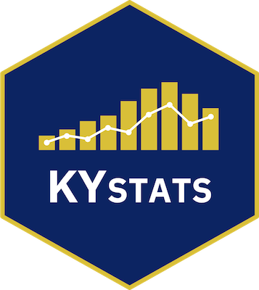
AN OVERVIEW
OF
APPRENTICESHIP
DATA

Slide 13

“We need to
better understand
the transitions along the education and workforce pipeline using data.”

Slide 14
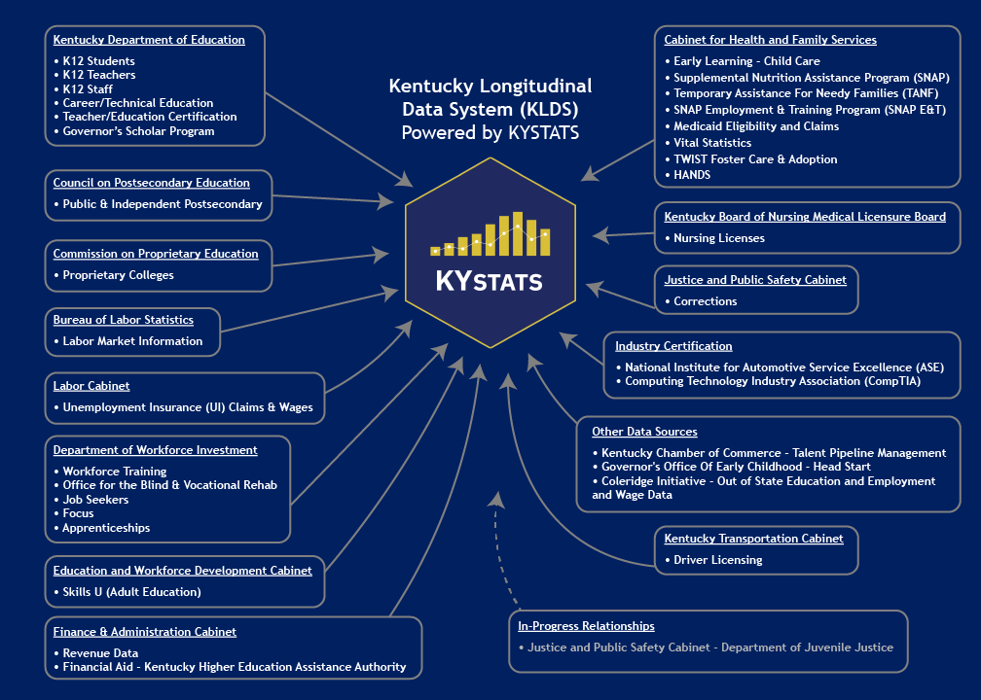

Slide 15
Questions…
Work-based learning?
Workforce programs?
Education/workforce outcomes?

Slide 16
How it started…
Partners could send us data
Registered Apprenticeship Partners Information Management Data System
Quarterly submissions for both establishments and apprentices
The Kentucky Workforce Dashboard

Slide 17
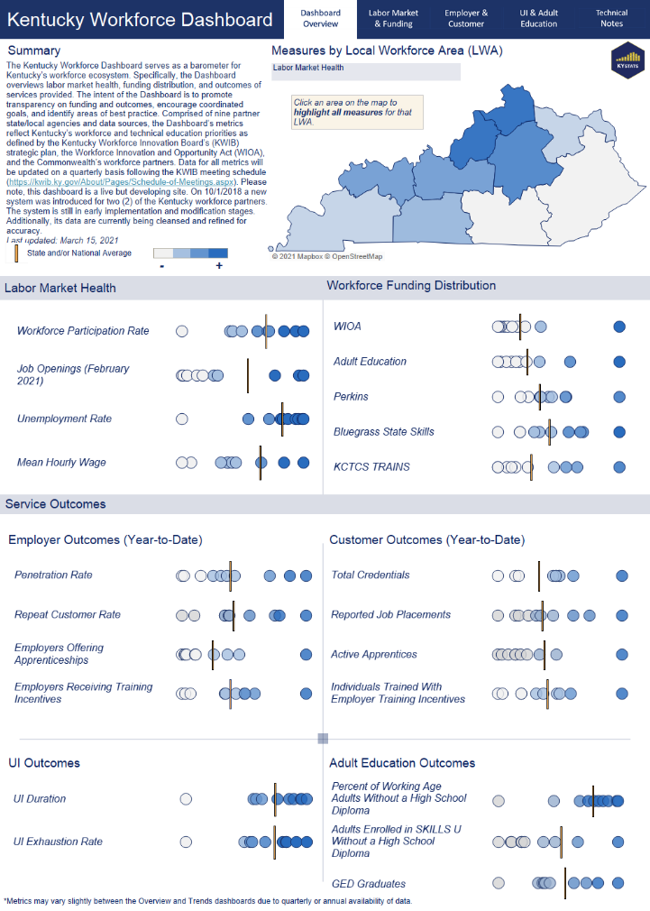
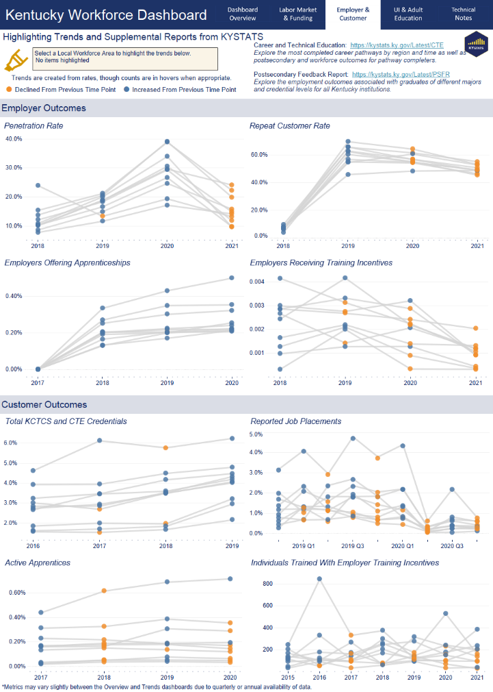

Slide 18
Issues?
Partners are busy, too
No real way to verify data accuracy
No PII to match into KLDS

Slide 19
Solution?
Access to RAPIDS data
Integration into the KLDS
High match rate
Can now produce outcomes

Slide 20
In progress…
Policy: HB 419
  Information for students
  Cost of attendance
  Outcomes by institution, major
  Additional pathways (CTE, apprentice)

Slide 21
In progress…
COVID-19: Q2-Q3 2020 Employment for Recent Grads
  Employment compared to prior years
  Equity lens: race, ethnicity, gender, region
  Are there gaps by credential or major?

Slide 22
Upcoming…
Apprenticeship Feedback Report
  Employment and Wages
  Employment Retention Rates
  Postsecondary Outcomes and/or Completion
  Equity focus

Slide 23
Dr. Jessica Cunningham
Executive Director
Jessica.Cunningham@ky.gov
Scott Secamiglio
Visual Analytics Director
Scott.Secamiglio@ky.gov

Slide 24


April 19, 2021
Registered Apprenticeship Iowa
Ryan Murphy, Iowa Workforce Development

Slide 25
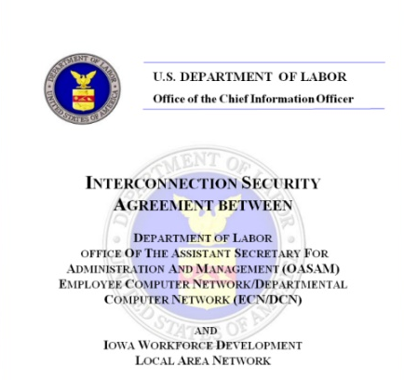
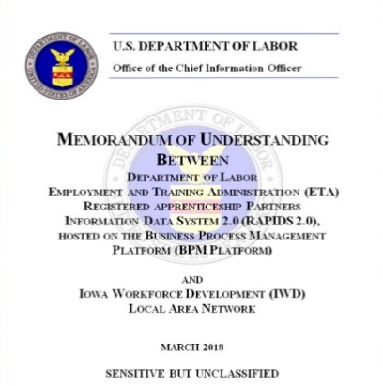
U.S. Department of Labor – Employment & Training Administration Data Sharing MOU
Iowa Data sharing agreement 2009
State Director of Apprenticeship
Department of Labor, Office of Apprenticeship D.C. (Dol.gov/agencies/eta/apprenticeship)
Interconnection Security Agreement
DOL & ETA Registered Apprenticeship Data MOU
Rapids 2.0 (Apprenticeship Data Management system)
3-Year MOU
Quarterly Data requests
Local DOL office of Apprenticeship staff

Slide 26

Registered Apprenticeship Employment
Personally Identifiable Information is included
  Unemployment insurance Wage records
  State longitudinal Data System
  Data Suppression
Data experience & partnerships
  10+ years of access
  Education, workforce, and Training data
  Multiple agencies
US Department of Labor, Local office
  Consideration
  communication
  explanation
  Collaboration

Slide 27

Future Ready Iowa Initiative & Registered Apprenticeship
Postsecondary education outcomes evaluation
  2012 Registered Apprenticeship Completers (4 years Post completion)
    Annual Median Earnings: $65,164
    Employment %: 88.9% Match to employment
  Highest earning RA Occupations (Median)
    Line maintainer
    Pipefitter
    Maintenance Mechanic
    Plumber
Educational attainment Goal: 70% of Iowans completing postsecondary Education or training by 2025
  Rewarding career path for adults
Promotion & marketing of registered Apprenticeship in Iowa
  earnandlearniowa.gov
  Iowa’s Career Coach (Futurereadyiowa.gov)

Slide 28
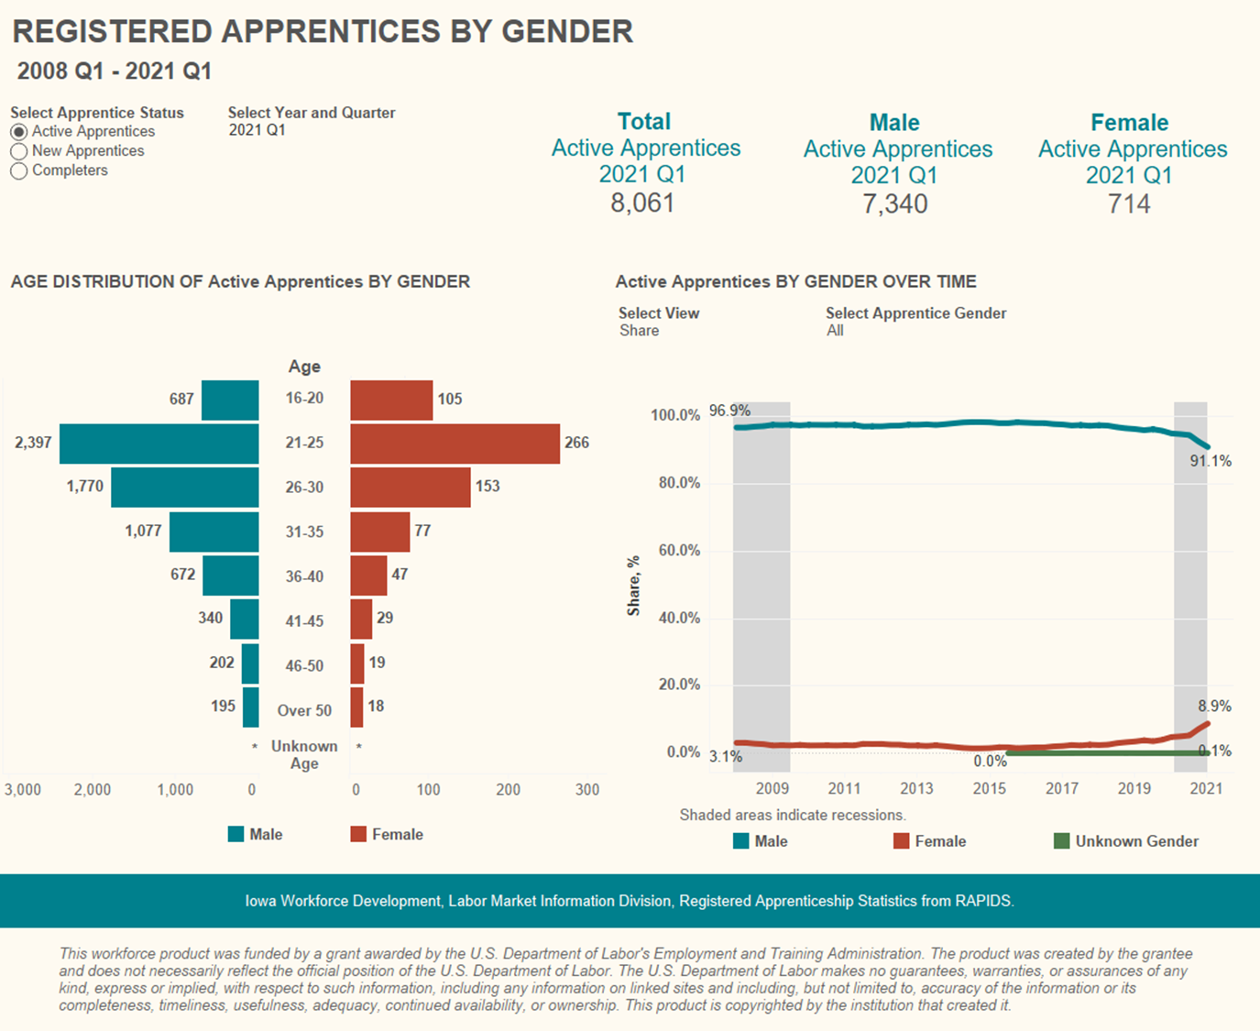

Slide 29
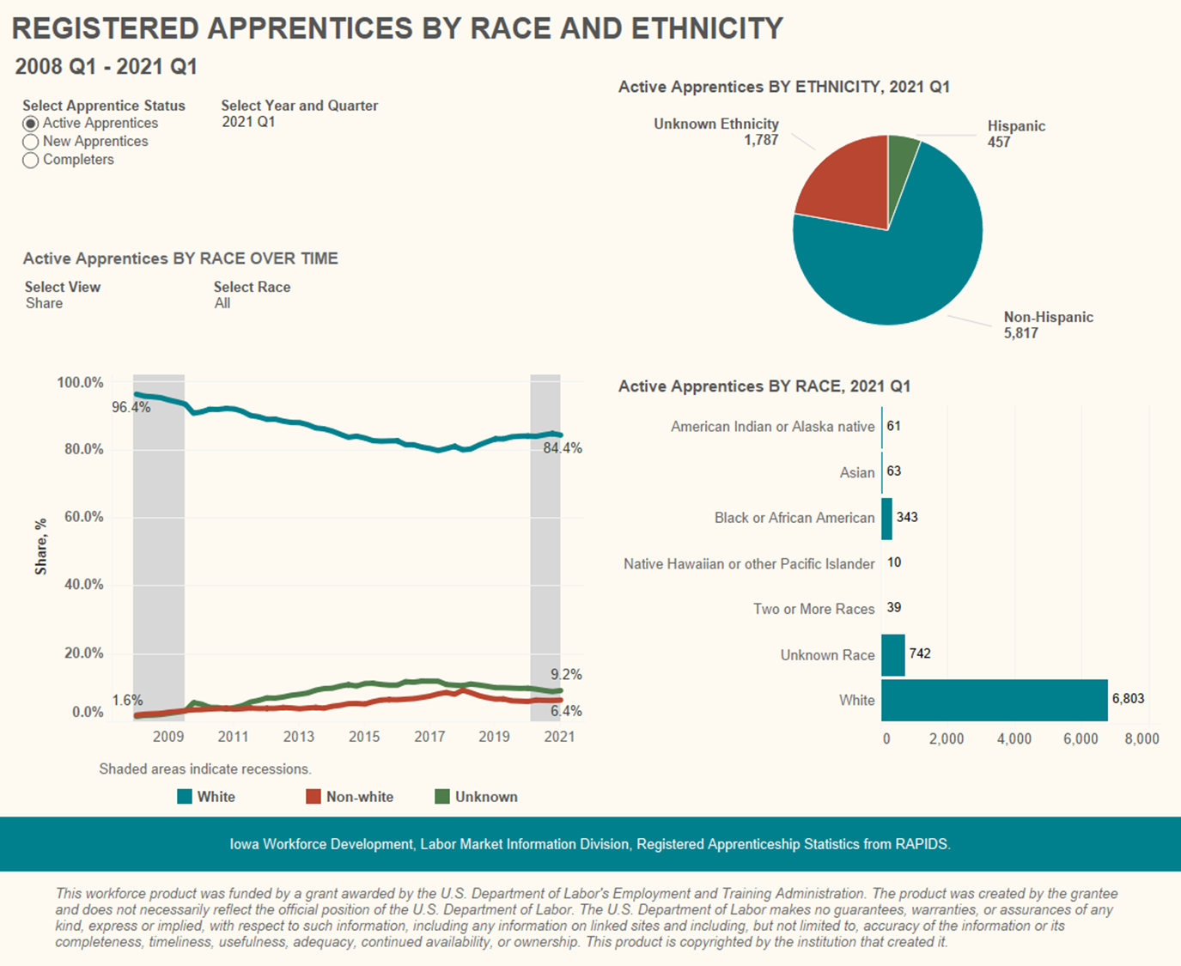

Slide 30
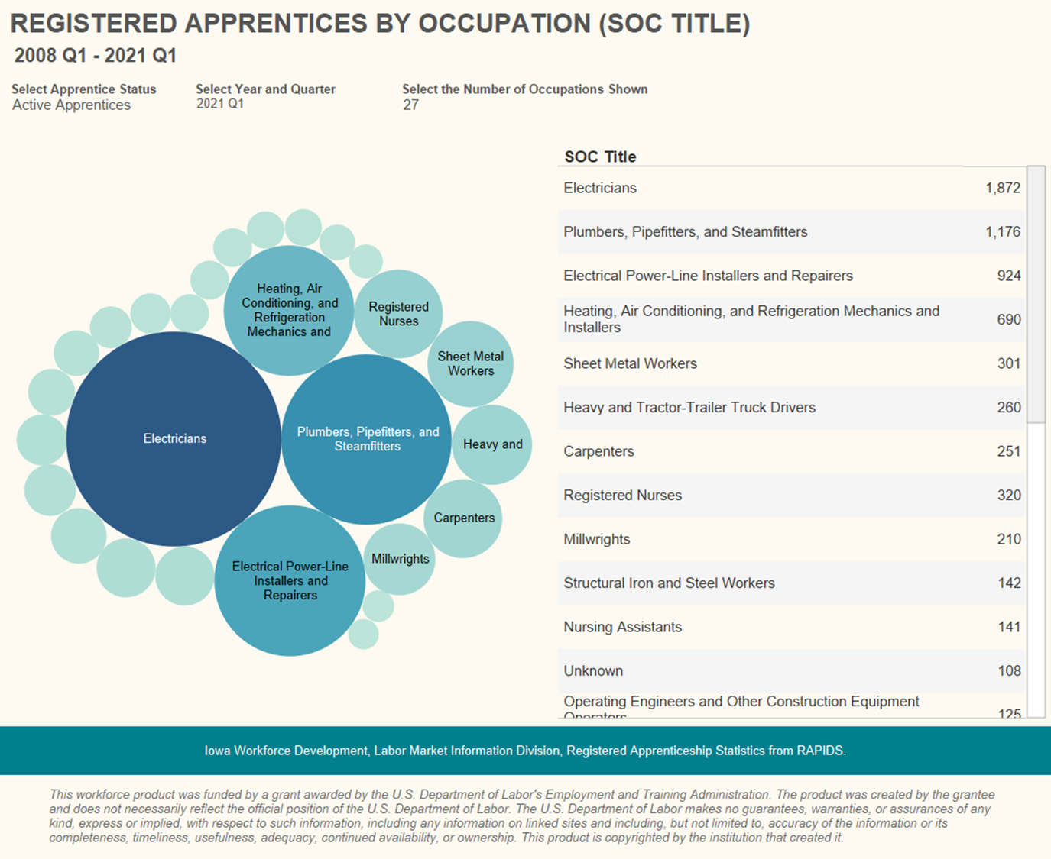

Slide 31
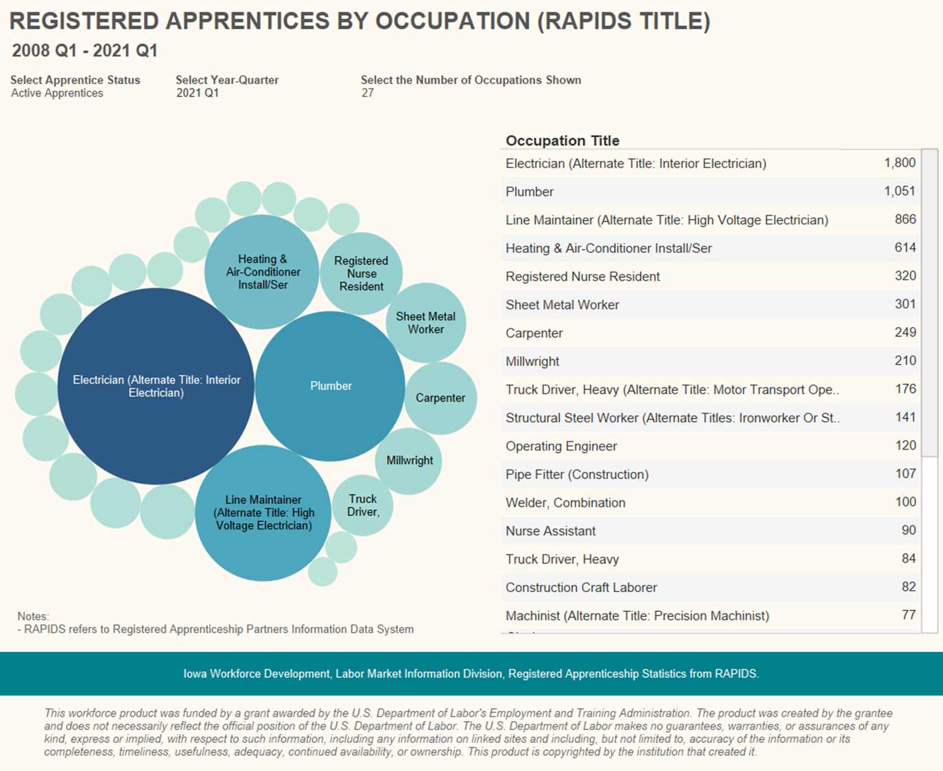

Slide 32
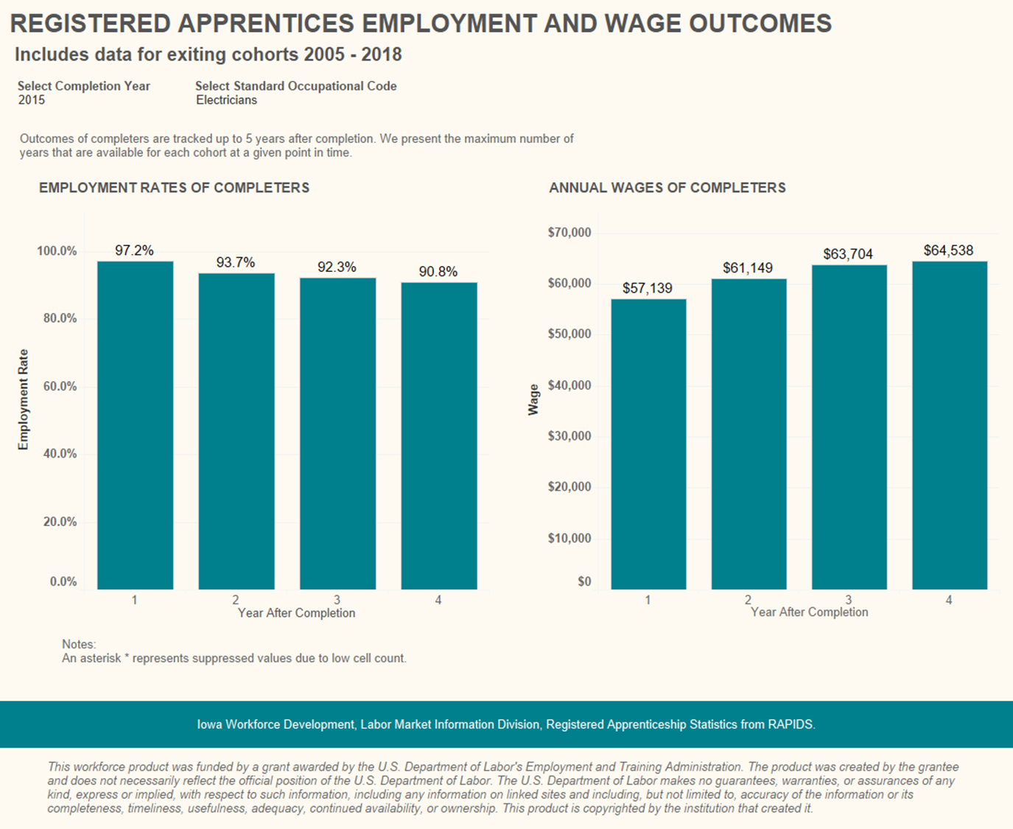

Slide 33
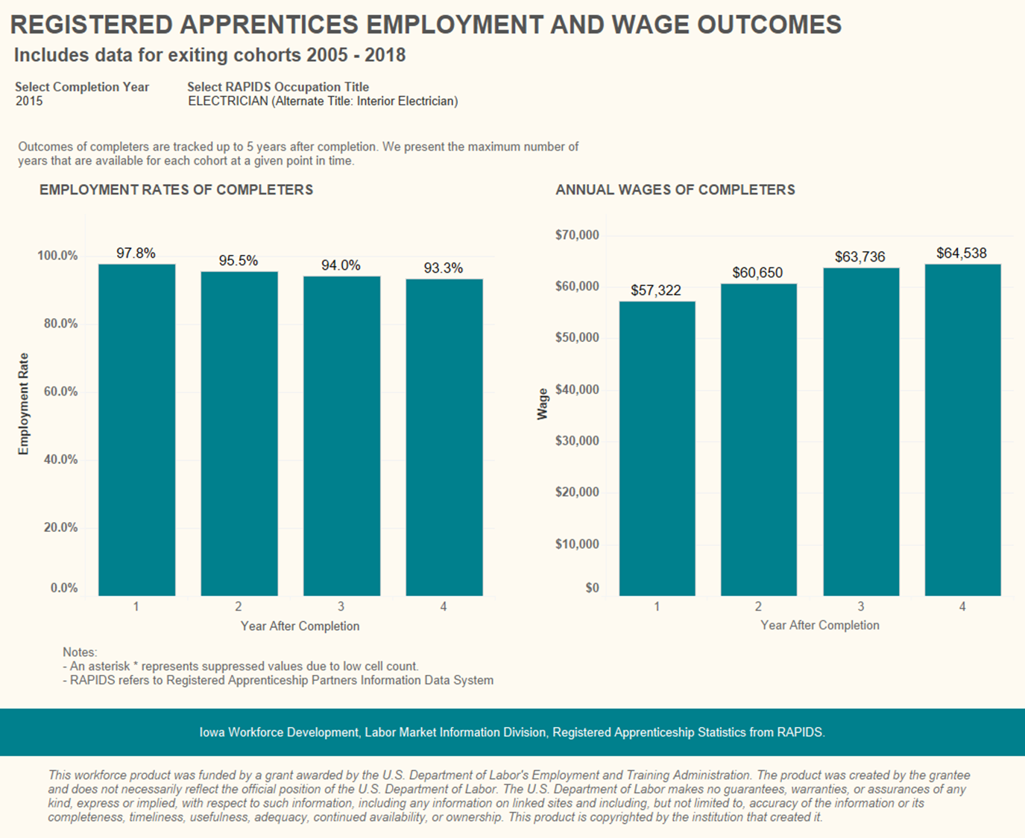

Slide 34
Iowa Workforce Development Contacts
Amy Beller
  Registered Apprenticeship Program Coordinator
  Amy.beller@iwd.iowa.gov
  (515) 725-1035
Ryan murphy
  Labor market information, Research & Analysis
  Ryan.murphy@iwd.iowa.gov
  (515) 281-7505

Slide 35
Questions?
Type your questions for the panelists into the Q&A feature on your screen.

Slide 36
Contacts
Contact Information
Tracy Korsmo, North Dakota, tkorsmo@nd.gov
Todd Willnow, North Dakota, twillnow@nd.gov
Jessica Cunningham, Kentucky, jessica.cunningham@ky.gov
Scott Secamiglio, Kentucky, scott.secamiglio@ky.gov
Ryan Murphy, Iowa, ryan.murphy@iwd.iowa.gov
James Basile, SLDS Program Analyst, james.basile@aemcorp.com
Jeff Sellers, SLDS State Support Team, jeff.sellers@sst-slds.org
For more info about the SST and to request support
SLDS Communities360 website, http://slds.ed.gov
Contact your state’s SST Point of Contact for assistance: https://slds.ed.gov/#communities/pdc/documents/14522

Slide 37
Thank you!

