Slide 1
Collaborating to Expand the CEDS Data Warehouse
The presentation will begin at approximately 11:00 a.m. ET.
In order to cut down on background noise, we have placed you on mute upon entry into the meeting.
During the question-and-answer portion of this presentation, type your question into the Chat panel.
A copy of this presentation and a link to the recording will be shared on the SLDS Communities360 site at https://slds.ed.gov.
To dial-in to the teleconference via phone: 1-646-357-3664 / Meeting ID: 149 825 0194

Slide 2
Collaborating to Expand the CEDS Data Warehouse
October 21, 2021
Kathy Gosa SLDS State Support Team
Duane Brown
Common Education Data Standards
Kathy Warren
Maine Department of Education
Leah Piatt
Maine Department of Education

Slide 3
Session Overview
Welcome and Introductions
CEDS Data Warehouse (DW) Expansion Project Background and Outputs
CEDS Data Warehouse Expansion Process
Maine’s Finance Use Case
Q&A
Wrap Up

Slide 4
CEDS Data Warehouse Expansion Project

Slide 5
Project Background
Data Warehouse History
CIID: Funded by a grant from the Office of Special Education Programs (OSEP)
Michigan’s Center for Educational Performance and Innovation (CEPI) V8.0.0.0
CIID/CEDS V9.0.0.0
Data Warehouse Expansion Project V9.1.0.0
Colorado Department of Education
Michigan’s CEPI
Numerous state and local agencies, organizations and solution providers
November 2020 through October 2021

Slide 6
Five Phases
Use case development
CEDS element development
Data model expansion
Data migration resource development
In development
Reporting output resource development
Items posted to the CEDS Open Source Community
In development

Slide 7
Demo Time!

Slide 8
CEDS Data Warehouse Expansion Process – How is this different?

Slide 9
From Project to Process: Aiming for the Target
Developing resources to meet the needs of the stakeholders
Round 1: Project from start to finish
Round 2 through ?: Begin when ready
Multitasking the five phases

Slide 10
CEDS Financial Use Case
Katherine Warren
Data Systems Manager
katherine.warren@maine.gov
Margaret L. Piatt
Data Warehouse Manager
margaret.l.piatt@maine.gov

Slide 11
Why does it matter?
Maine’s experience with a Standardized Chart of Accounts puts us in a unique position to share with the broader community how we have adopted and implemented the NCES standard.
We want to be a part of the effort to automate federal submissions wherever possible.

Slide 12
History
Maine Education Financial System (MEFS)
2008
Established standard account number format
NCES Financial Accounting for Local & State School Systems
Basis for Financial Accounting for Local School Systems in Maine 2021 ed.
Maine DOE Model Chart of Accounts

Slide 13
History
Engaged with financial stakeholders
School business managers
Accounting system vendors
State school finance officers

Slide 14
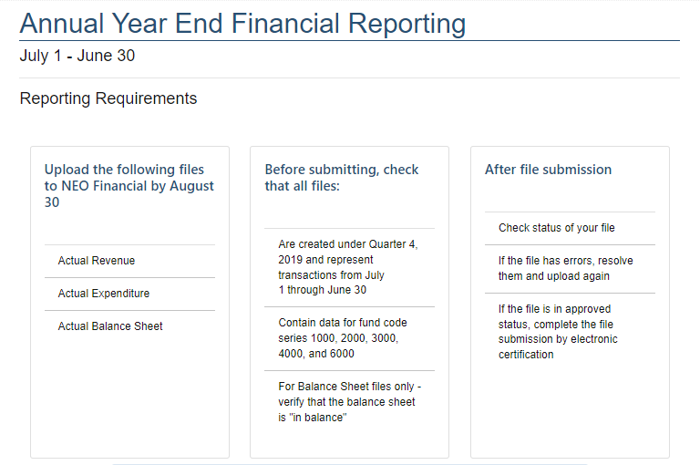
Current State

Slide 15
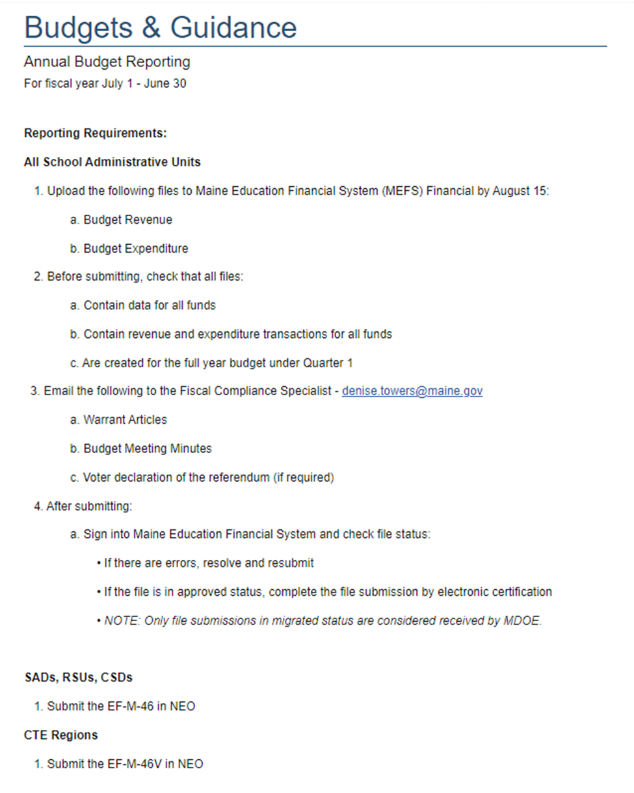
Current State

Slide 16
Current Reports
Balance Sheet by SAU
Budget to Actual Report
CTE Report
Debt Service Expenditures
Expenditures by SAU
G&T Expenditures
Handbook Code Query
Most Recent Migrated Submission
Per Pupil Operating Cost
Reported to Adjusted Submission
Resident Expenditure by Budget Category
Revenues by SAU
Special Education
Transportation Operating Report
Tuition Computation
Report Codes List
Handbook Code by Validity
Maintenance of Effort Report
Excess Cost Report
F33 Report
F33 SLFS Report

Slide 17
Use Case
Timeline (Fall 2021 – Spring 2022)
Fall 2021
Review Project requirements
Winter 2022
Align elements needed
Complete requirements
Spring 2022
Submit use case to the community
Review feedback with technical support

Slide 18
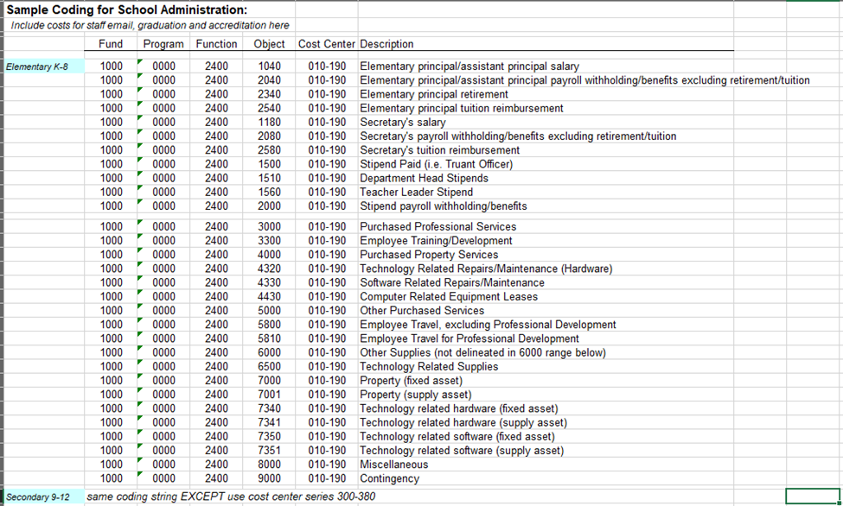
Data Elements

Slide 19
CEDS Data Warehouse Expansion Next Steps

Slide 20
Finance Use Case
Kick-Off: Tuesday, November 2 at 2:30 p.m. ET
https://ceds.communities.ed.gov/#program/events/7527

Slide 21
Finance Use Case
Meetings
November 2, 2021 – October 4, 2022
Monthly Update Meeting on the first Tuesday of every month
Additional meetings as needed for element development and data modeling
Participation Levels
Level 1: Gain Knowledge
Level 2: Influence
Level 3: Develop / Subject Matter Experts

Slide 22
Questions?
Type your questions into the Chat feature on your screen.

Slide 23
Resources
SLDS System Design Toolkit, https://slds.ed.gov/#program/system-design-toolkit
Common Education Data Standards, https://ceds.ed.gov
CEDS Data Warehouse Expansion Project, https://ceds.communities.ed.gov/#communities/ceds-osc/workgroups/ceds-dw-expansion
CEDS Open Source Community, https://github.com/CEDStandards
CEDS Data Warehouse Expansion Project one-pager, https://slds.ed.gov/#communities/pdc/documents/20250
CEDS Data Warehouse Contributor Guidelines, https://github.com/CEDStandards/CEDS-Data-Warehouse/blob/master/Contributing.md

Slide 24
Contacts
Contact Information
Leah Piatt, Maine Department of Education, margaret.l.piatt@maine.gov
Katherine Warren, Maine Department of Education, katherine.warren@maine.gov
Kathy Gosa, SLDS State Support Team, kathy.gosa@sst-slds.org
Duane Brown, CEDS, duane.brown@aemcorp.com
For more info about the SST and to request support
SLDS Communities360 website, http://slds.ed.gov
Contact your state’s SST Point of Contact for assistance: https://slds.ed.gov/#communities/pdc/documents/14522

Slide 25
Thank you!

