Slide 1
Creating New Infrastructure in Wisconsin:
Adding School Choice to the WISE System
A recording of this webinar is available at https://youtu.be/7ViIWYAHlz4.

Slide 2


Creating New Infrastructure in Wisconsin: Adding School Choice to the WISE System
October 26, 2021
John Raub
Wisconsin Department of Public Instruction
Kathi Gillaspy
SLDS State Support Team

Slide 3
Session Overview
Background Information
State Perspective
Q & A
Wrap Up

Slide 4
FY19 SLDS Grant Priority: Educational Choice
Applicants seeking funding under this priority should describe how they would use their data system to support education choice initiatives in their state. If funds are requested under this priority, applicants must explain what is meant by education choice in their state and in their application and how their state data system would be used to support education choice–related initiatives.
FY19 Educational Choice State: Wisconsin

Slide 5
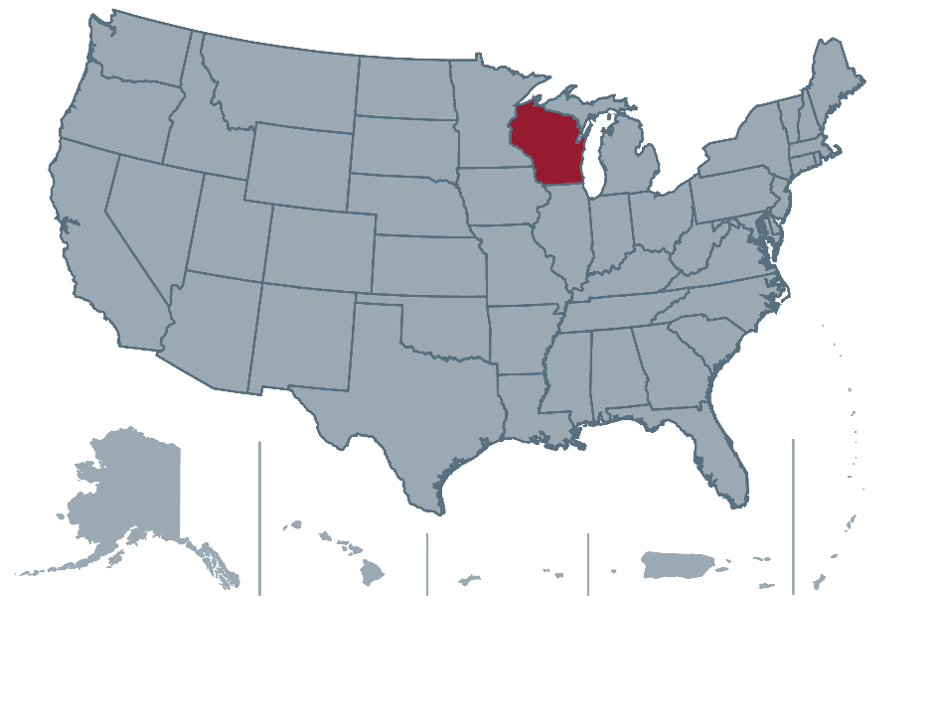
State Perspective
John Raub, Wisconsin Department of Public Instruction

Slide 6
Title Slide
Improving Infrastructure to Include
Wisconsin’s School Choice Programs
John Raub
Product Owner, WISEdata Ed-Fi Applications Development
October 26, 2021
www.dpi.wi.gov

Slide 7
Sample with XL chart or image
What Will We Cover?
2019 SLDS Grant Overview
Overview of the WISE Systems
Review of Parental Education Option Systems in Wisconsin
Putting It All Together: Where Is Wisconsin on Its Grant Outcomes?
Questions

Slide 8

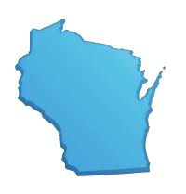
Wisconsin’s Education System
2020-21
  421 public school districts (LEAs)
  2,173 schools
  829,935 students
  113,911 FTE (all staff)
782 Private Schools
  118,862 private school students
WISEdash Public Portal

Slide 9
2019 SLDS Grant Overview
Outcome 1: Modernize Enterprise Data Systems
Outcome 2: Integrate DPI’s Education Choice Systems
Outcome 3: Streamline the School Financial Membership Application (PI-1563)
Outcome 4: Support the Partnership With UW-Madison on Connecting Research, Evaluation, and Practice
Notes:
Need for a project: Too many disconnected data systems. Our WISE systems are a big improvement, but still do not connect with key data systems that need to connect on student and financial data.
Outcome 1: Rebuild Enterprise and School Directory - Enterprise is the agencies primary database in which almost all DPI systems need and integrate with. DPI needs an easier way to collect, maintain, and share core educational structure data across the agency, while improve usability for external users.
Outcome 2: Automate data collections programs that are currently paper based, and a focus on integrating new and current systems with the WISE systems.
Outcome 3: Integrate DPI School Financial Service Systems with both the WISE and Wisconsin Choice Systems to obtain membership and other student counts used for fiscal purposes.
Outcome 4: Partnering with the University of Wisconsin to leverage new data elements to address problems of practice identified by DPI and educators, with the goal of supporting educational equity and quality improvements in the state.

Slide 10








WISE Systems Overview
Open data collection system
A data portal that
uses “dashboards” to provide multi-year education data about Wisconsin schools
A cost-effective,
efficient way of making top-quality resources available to the whole state through one easy-to-use portal
Data-driven school improvement planning
Notes:
As background, WISE stands for Wisconsin Information System for Education
WISE is comprised of all of our tools that we created that integrate with one another.

Slide 11
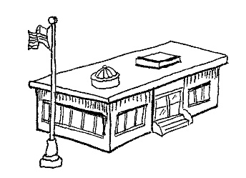



WISE System Applications
WISEdash Public Portal
WISEdata Portal
WISEadmin
WISEid
WISEStaff
WISEsecure
Ed-Fi Credential
WISEhome
WISEdash for Districts
Wisconsin Districts and Schools
Student Information System (SIS)
Behavior & Discipline Systems
College & Career Readiness Software
School Finance Management System
Special Education Information System
Student Assessment
Student Immunization
WISEid
WISEid
WISEsearch Student/Staff Identify API
WISEsearch Student/Staff Identify API
Data Warehouse / Snapshot Reporting
DPI Ed-Fi Year DBs
Agency ODS
API
Validations
ETL
State and Federal Reporting

Slide 12

WI DPI Reporting: WISEdata Pipeline
Data Entry to
SIS or Vendor
Product
District enters data daily, including data required for collections
District can continue to update data after the snapshot, but updates are not guaranteed to be reflected in outputs
REAL-TIME*
L1 errors sent back to SIS
N
Certified
Snapshot
Date?
Ed-Fi API
SIS data consumption & L1 validation
Data Snapshot
Y
State and Federal Reporting
District user goes back to SIS and makes changes based on validation and data quality metric results
WISEdata Portal L2 Validations & Quality Metrics
District uses portal to review data quality metrics and validation results to fix data in SIS

Slide 13
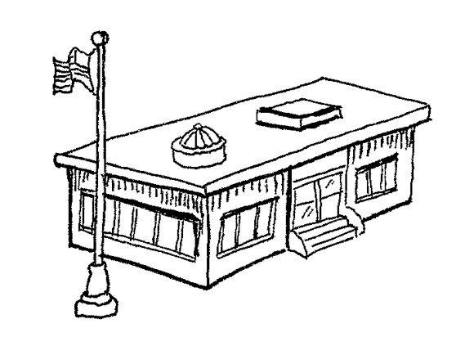
Wisconsin Parental Education Options
Public Districts and Schools
Charter Schools
Private Schools
Private School Choice (Voucher) Program
  Milwaukee
  Racine
  Statewide
Home-Based Private Education (Homeschooling)
https://dpi.wi.gov/parental-education-options
Notes:
The state’s four private school parental choice programs(4) reported a combined third Friday of September 2020 headcount of 45,954
https://dpi.wi.gov/news/releases/2020/dpi-releases-fall-student-count-and-revenue-limit-information
Public districts, schools, charter schools, and choice students are reported in WISE

Slide 14
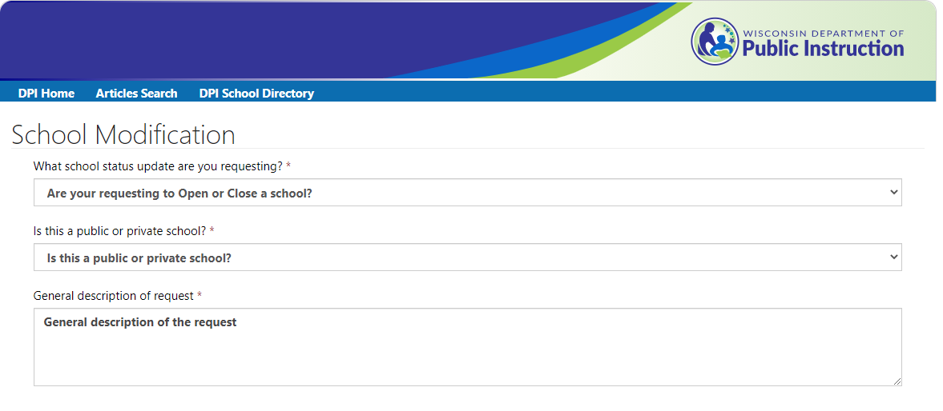
Outcome 1: Modernize Enterprise Data Systems
School Modification Request Form
https://dpi.wi.gov/cst/data-collections/school-directory/directory-application/school-modification

Slide 15
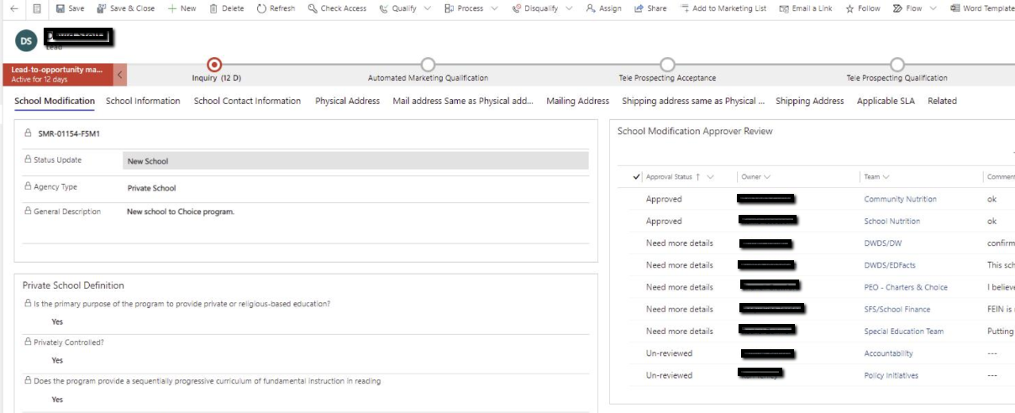
Outcome 1: Modernize Enterprise Data Systems
School Modification Workflow: Microsoft Dynamics 365
https://dpi.wi.gov/cst/data-collections/school-directory/directory-application/school-modification

Slide 16
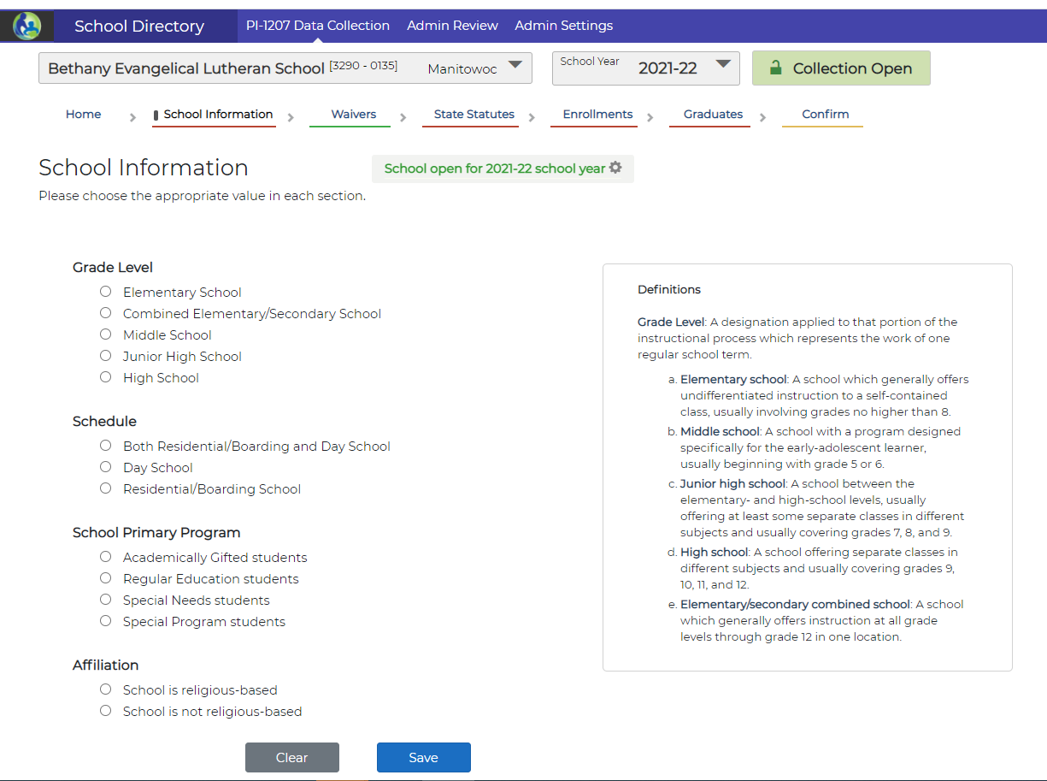
Outcome 1: Modernize Enterprise Data Systems
PI-1207 Private School Report Application
  Update and confirm school information
  Includes DPI Administrative Functions
https://dpi.wi.gov/cst/data-collections/pi-1207-data-collection

Slide 17


Outcome 1: Modernize Enterprise Data Systems
What Is Next?
  Database migration to Microsoft SQL Server
  Creation of a new School Directory Application

Slide 18
Outcome 2: Integrate DPI’s Education Choice Systems
Open Enrollment Transportation Reimbursement Program (TRIP)
  TRIP collects transportation cost data from low-income families with students who are open-enrolled in a nonresident public school district.
  What is open enrollment? The interdistrict public school open enrollment program allows parents to apply for their children to attend public school in a school district other than the one in which they reside.
https://dpi.wi.gov/open-enrollment
https://dpi.wi.gov/open-enrollment/applications/transportation

Slide 19
Outcome 2: Integrate DPI’s Education Choice Systems
TRIP
  New app connects to WISEdata to verify family income eligibility and Open Enrollment system to verify student eligibility
  Deployed on April 28, 2021
  Claims window went from May 28 to July 15, 2021
  1,368 claims were created
  Reduced claims requiring follow up by 38%
  96% of claims were approved for pay, an improvement of 24%
Notes:
New app replaced online form (Vovici) submitted by users and Microsoft ACCESS data entry / queries used by DPI for processing claims

Slide 20
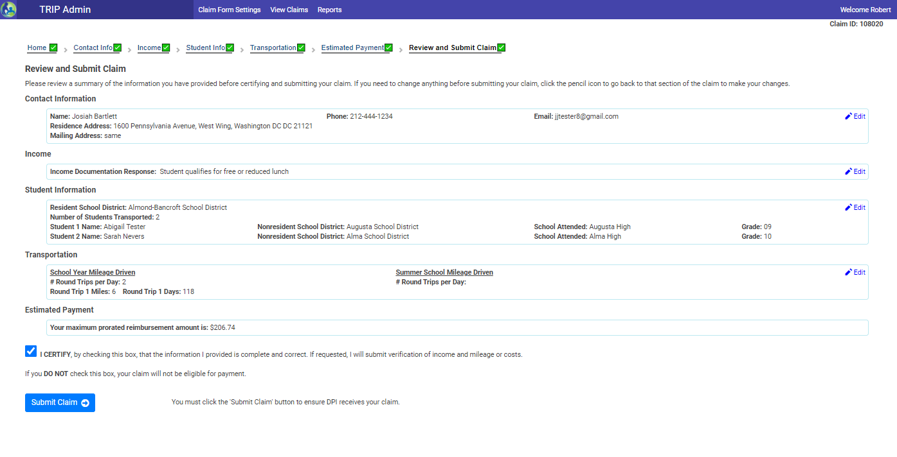
Outcome 2: Integrate DPI’s Education Choice Systems
* The data displayed on this screen are fictitious test data
Notes:
Contains Google Maps integration to calculate mileage.

Slide 21
Outcome 2: Integrate DPI’s Education Choice Systems
What Is Next?
  Creation of an online Special Needs Scholarship Program (SNSP) Application
    https://dpi.wi.gov/parental-education-options/special-needs-scholarship/student-applications
  Integration of WISEid
    Wisconsin Choice System Application
    Wisconsin Open Enrollment System Application

Slide 22
Outcome 3: Streamline the School Financial
Membership Application (PI-1563)
Pupil Count PI-1563
  Membership information and reporting
  Goal to integrate data used by the School Finance Reporting Portals with the WISE Systems, building off the data pipeline already established
  Analysis currently in process
  Requires integration with PEO systems in addition to the WISE application suite
Notes:
Another goal of the project is to allow the DPI School Financial Services (SFS) team to obtain membership and other student counts used for fiscal purposes from the WISEdata student data collection system. This would eliminate duplicate data collections, streamlining processes to save time and improve data quality.
Much of Wisconsin school funding is tied to membership, which is the count of resident students of a district deemed in law to be financially responsible provision of education. Over $5 billion in state aids are determined using membership and other student counts.
Due to the methods Wisconsin has enacted to fund the expansion of public and private choice, building the data systems necessary to connect those programs with pupil membership is vital.

Slide 23
Wisconsin’s FY19 SLDS Year 2 Outcome Map
Resources
Strategies
Outputs
Expected Outcomes
WISE Steering Committee
Reviews and prioritizes IT vision and projects
Enhanced Enterprise Architecture
Improved customer satisfaction for parents and LEA staff
Improved data quality
Timely processing results, saving time for LEA and DPI staff
Defines scope and makes project assignments
Uses Scrum@Scale Framework to coordinate work and improve practices
Automated paper forms into online application processing to improve parent experiences
WISE Leadership Team
Performs iterative development to deliver workable software that provides value
Integrate WISEdata and WISEid to Wisconsin Choice and School Finance Systems
Scrum Dev Teams
Conducts sprint planning, sprint review, sprint retrospective, and daily standups
Automate and streamline workflow by integrating WISE, PEO, and SFS data systems
External Advisory Groups
Establishes application-specific user groups for parents and school staff

Slide 24
Questions?
Type your questions for the panelists into the Chat feature on your screen.

Slide 25
Contacts
Contact Information
John Raub, Wisconsin Department of Public Instruction, john.raub@dpi.wi.gov
Kathi Gillaspy, SLDS State Support Team, kathi.gillaspy@sst-slds.org
For more info about the SST and to request support
SLDS Communities360 website, http://slds.ed.gov
Contact your state’s SST Point of Contact for assistance: https://slds.ed.gov/#communities/pdc/documents/14522

Slide 26
Thank you!

