Slide 1
Planning for ECIDS Development: System Design Considerations
A recording of this webinar is available at https://youtu.be/FsvXXMqVXD0.

Slide 2
Planning for ECIDS Development: System Design Considerations
August 26, 2021
Mike Jolley
Utah Early Childhood
Stephen Matherly
Utah Early Childhood
Hayley Young
North Carolina Department of Health and Human Services
Tanya Morgan
North Carolina Department of Health and Human Services
Amy Nicholas
SLDS State Support Team
Jeff Sellers
SLDS State Support Team
Notes:
Amy

Slide 3
Webinar Purpose
To review considerations for the initial and ongoing design and development of an early childhood integrated data system (ECIDS).
To share updates on progress of the Utah and North Carolina ECIDS initiatives, including:
how their systems have evolved over time;
key decisions about infrastructure; and
plans for future enhancements.

Slide 4
Webinar Agenda
Welcome and Introductions
National Perspective
State Perspectives: Utah & North Carolina
Q & A
Wrap-Up & Technical Assistance Resources
Notes:
Amy

Slide 5
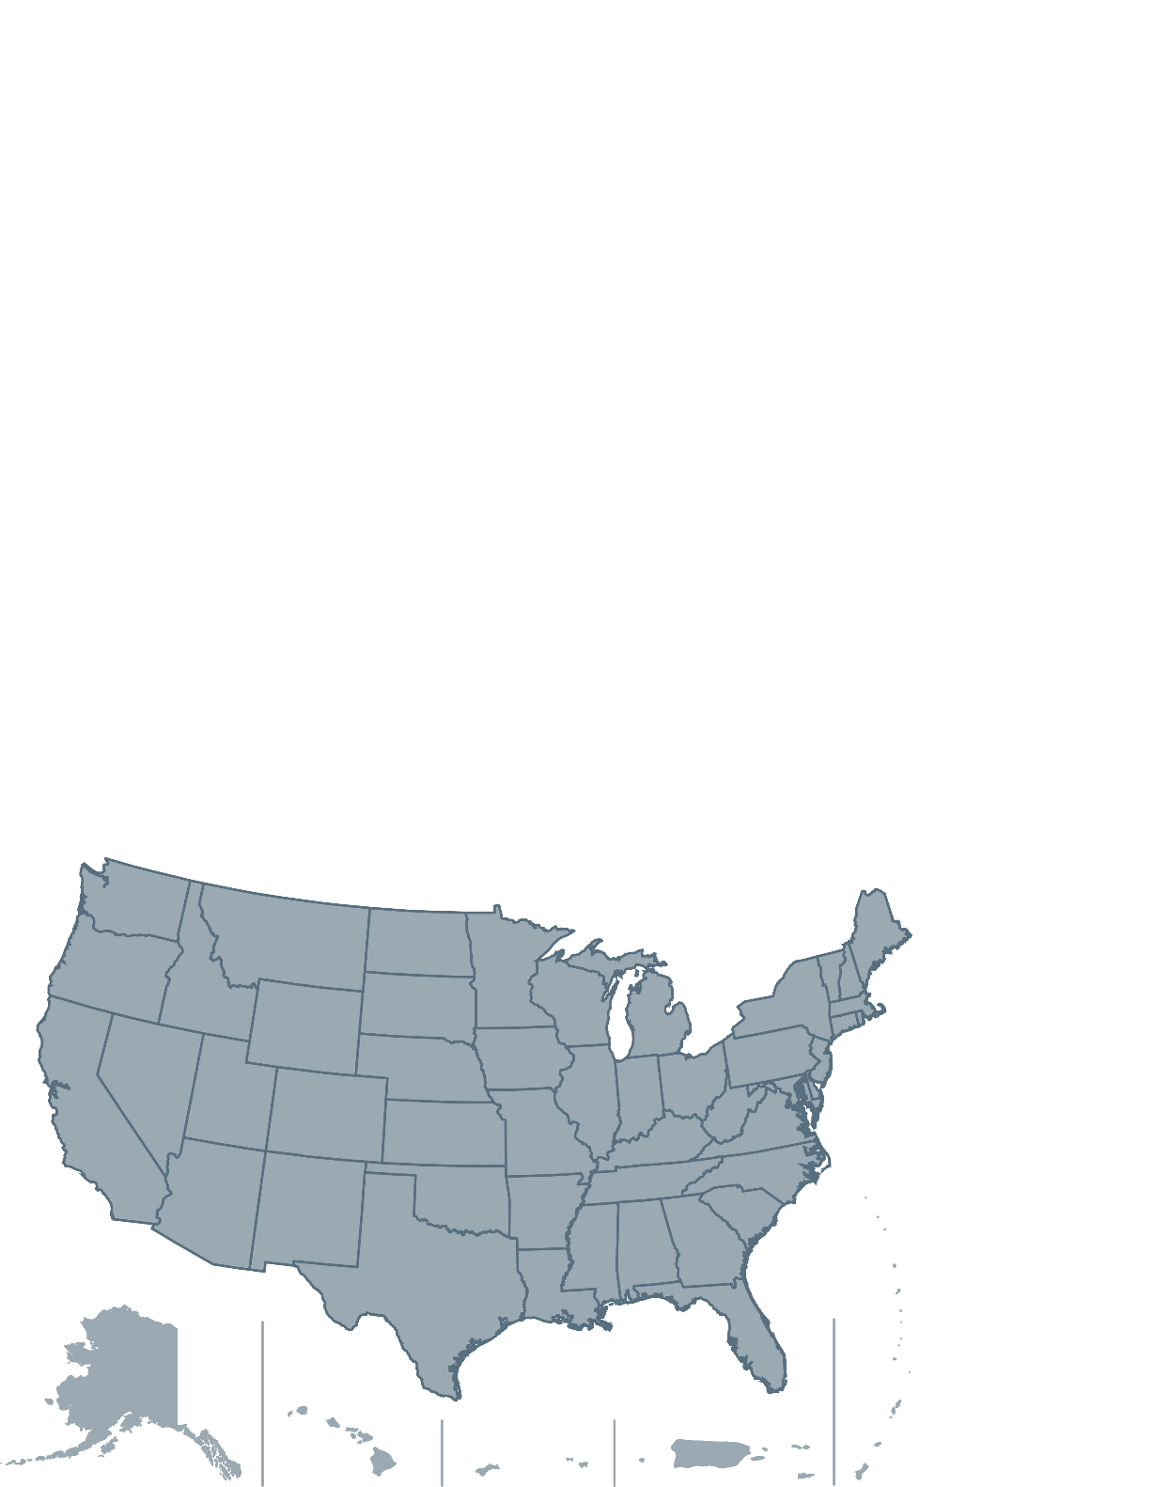
National Perspective
Status of early childhood data integration work
ECIDS technical infrastructure models
Notes:
Amy

Slide 6
Where Are Early Childhood Data Housed? (2018)
N=51
Notes:
Amy

Slide 7
From Which Programs Are Early Childhood Participation Data Directly Linked? (2018)
N=51

Slide 8
Is There a Comprehensive Data Dictionary for Early Childhood Data Elements That Contains Metadata Such As a Definition, Option Sets, Type, or Field Length?
N=51
Notes:
Comprehensive = includes definitions option sets, field type, length, etc.

Slide 9
Are Early Childhood Data Elements CEDS Aligned?
N=51

Slide 10
How Are Early Childhood Data Used-Top 10? (2018)
N=51

Slide 11
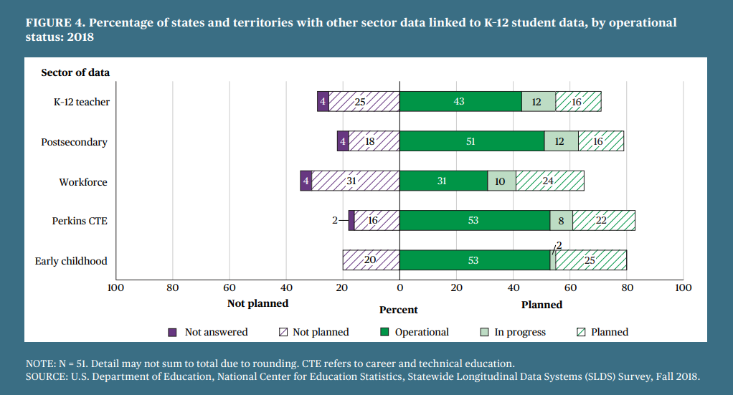
Linking Early Childhood to K12 Data
Profile of State Data Capacity in 2018: Statewide Longitudinal Data Systems (SLDS) Survey Descriptive Statistics (NCES, April 2021)
Notes:
Amy
80 percent of states and territories report planned, in progress, or operational automated linkages between K–12 and early childhood data.

Slide 12
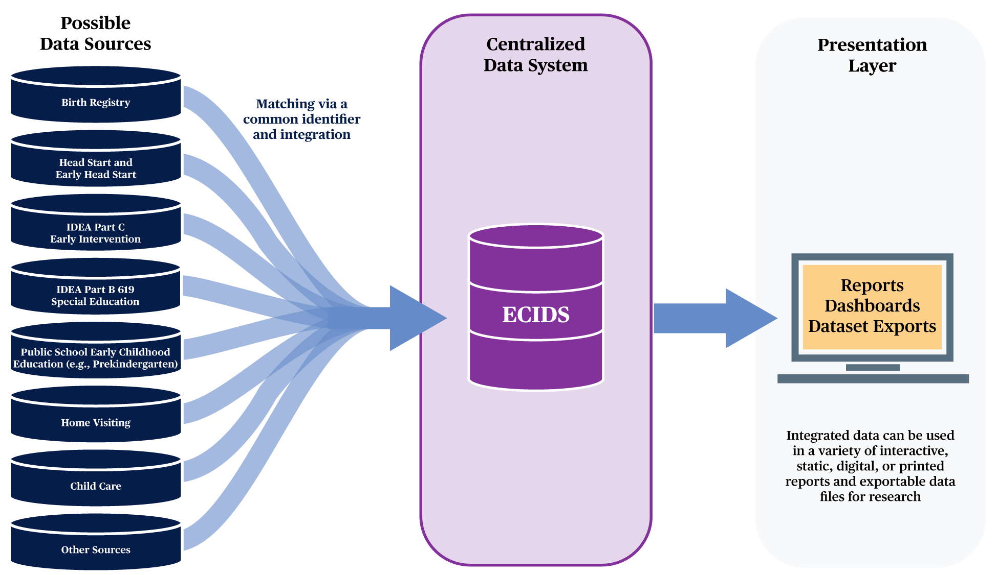
ECIDS Infrastructure: Centralized Model
Notes:
Jeff
There are three primary models for integrating early childhood data into an ECIDS or into the P-20W+ SLDS: centralized, federated, and hybrid.
Under a centralized data system model, early childhood data from across all participating programs and agencies are copied to a single, centrally located data repository where they are organized, integrated, and stored using a common data standard. Once the data are incorporated into a centralized ECIDS, the state can then feed appropriate data into the P-20W+ SLDS, if needed.
Centralized models have the following strengths:
Queries and reports can be run easily and in a timely manner.
The ECIDS produces consistent data.
It is easier to create a wide range of short- and long-term data reports.
Centralized models have the following limitations:
The consolidated database requires extensive support, including a database administrator, storage capacity, and server.
The public may be concerned about children’s personally identifiable information being stored in one place or misused.

Slide 13
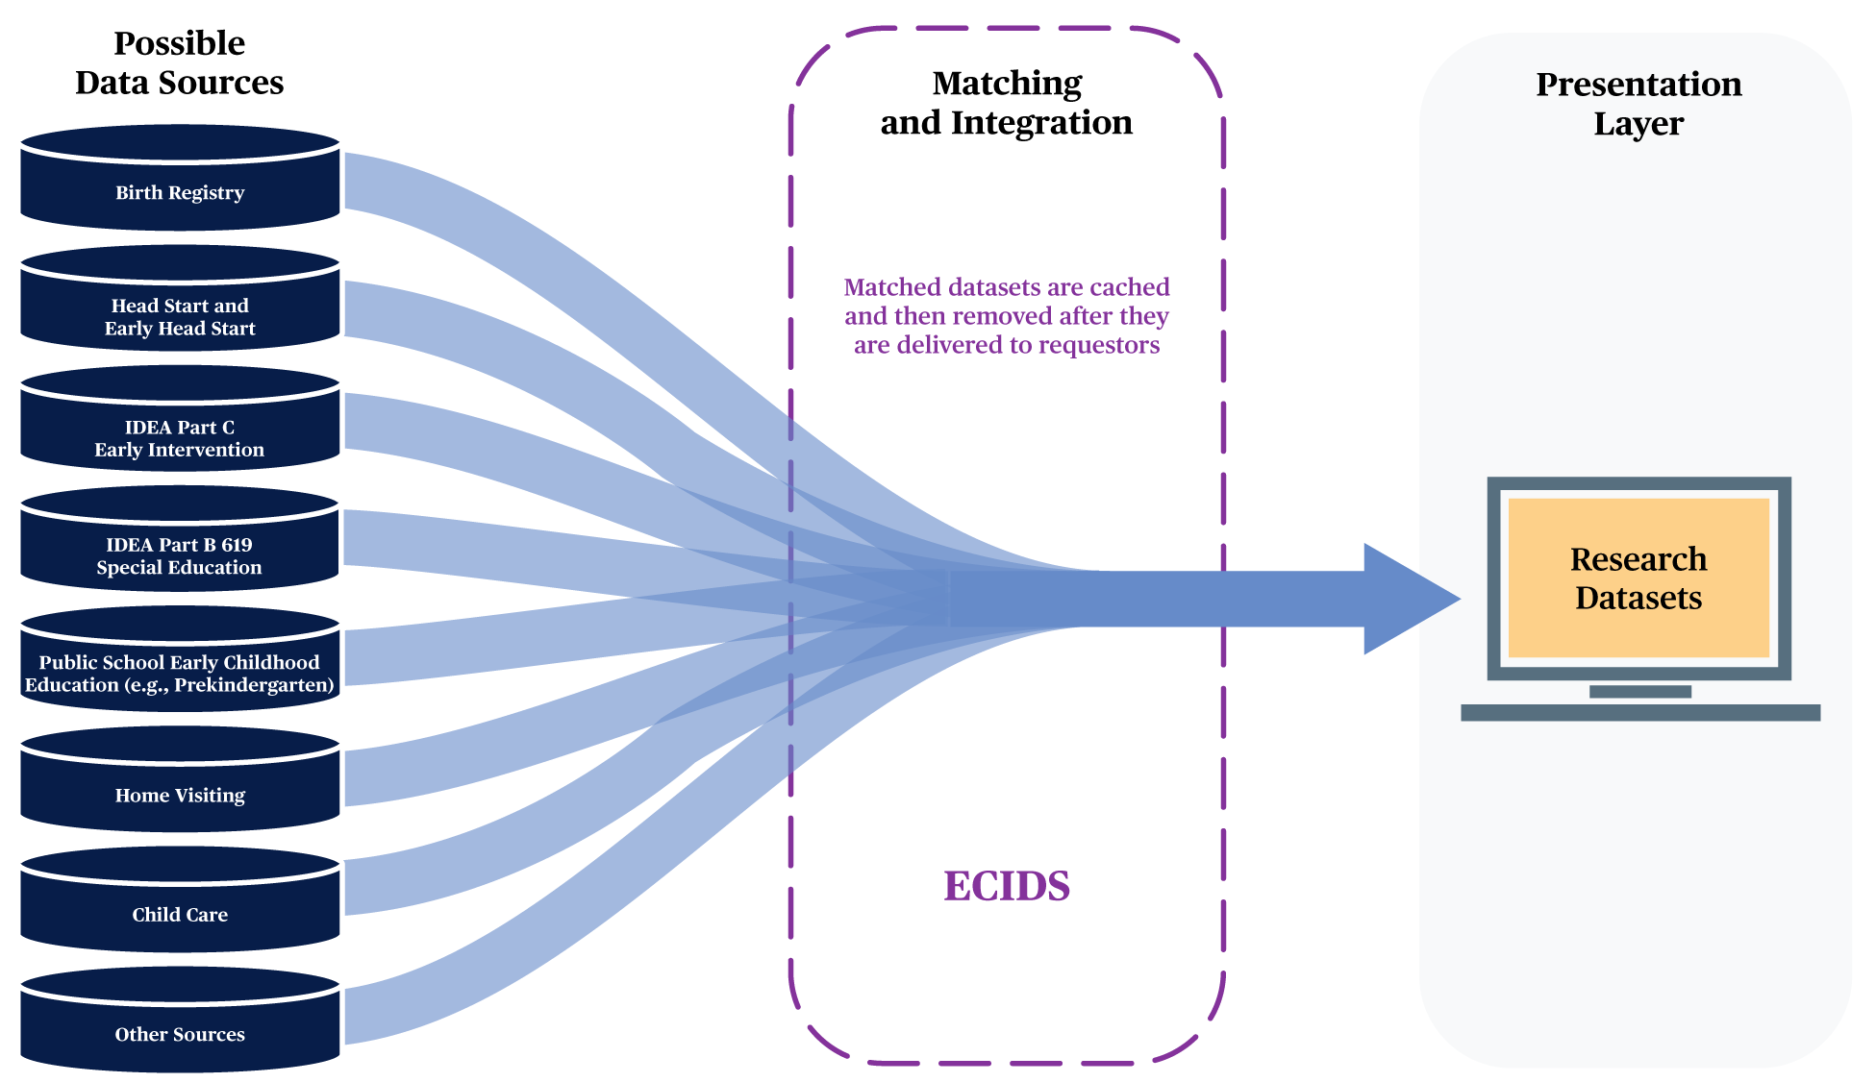
ECIDS Infrastructure: Federated Model
Notes:
Jeff
In a federated data system model, participating early childhood programs and agencies maintain control over their own data but agree through memoranda of understanding or data sharing agreements to share the data with other ECIDS partners upon request
Federated models have the following strengths:
There is no costly, centralized database to support.
Fewer resources are needed.
There are fewer concerns about storing all child-level data in a central location.
Federated models have the following limitations:
Determining longitudinal cohorts across data systems is challenging.
The system can only produce limited-purpose data files; long-term and stored datasets are not available.
The system cannot produce reports that rely on persistent data linkages.
. The linked data are not stored by the ECIDS, but rather are cached, delivered to the requestor, and then removed.

Slide 14
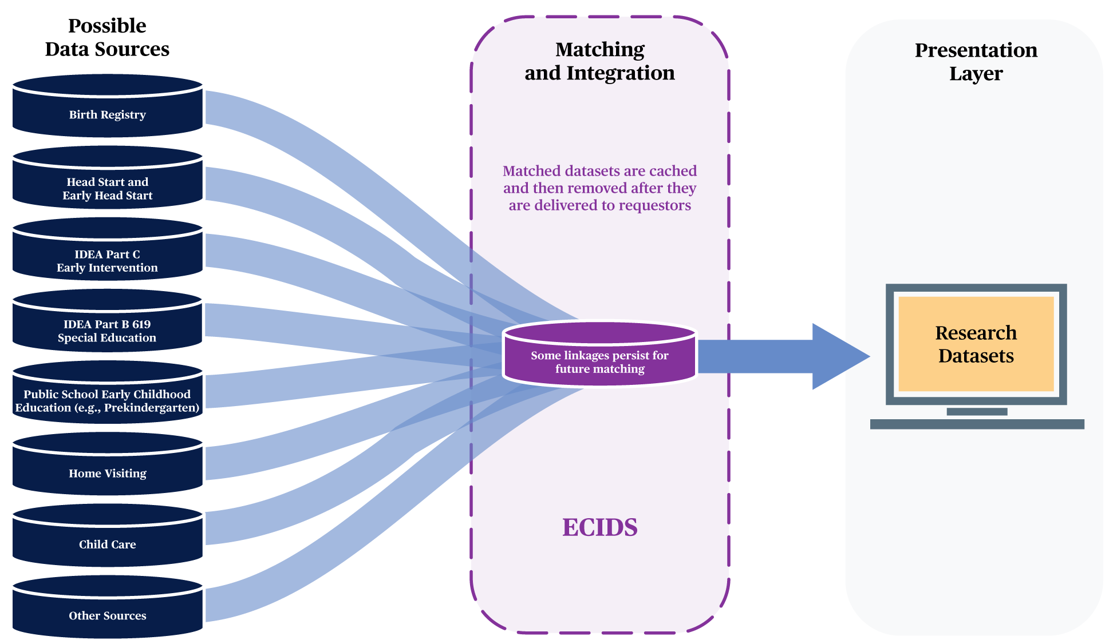
ECIDS Infrastructure: Hybrid Model
Notes:
Jeff
A hybrid data system model combines features of the centralized and federated models to meet the state’s unique circumstances. Early childhood data generally are not consolidated from across all participating programs and agencies. As in a federated model, each program or agency feeds appropriate data into the ECIDS or potentially into the P-20W+ SLDS directly from its own data source. However, as in a centralized model, linkages between data from multiple sources may persist in a hybrid model.
Hybrid models have the following strengths:
The matching process is done only once.
Persisting data linkages cut down on processing time.
The system does not need a large central database or significant support to manage matched data.
The primary weakness of a hybrid model is that it faces similar reporting and cohort-defining challenges as a federated model.
States can take a number of approaches to protecting personally identifiable information (PII) across all three types of models, such as including only de-identified data in the ECIDS. It is critical to evaluate the benefits and limitations of any approach or model based on the outcomes your state hopes to achieve.

Slide 15
The Four-Stage Process of ECIDS System Design
Assess
Design
Develop
Implement
Review state’s goals and vision to determine needs and requirements and set objectives
Based on requirements, determine the best system model to meet state objectives (e.g., centralized vs. federated) and UIDs
Develop system architecture and identify technology requirements
Implement system and deliver to stakeholders
Notes:
Jeff

Slide 16
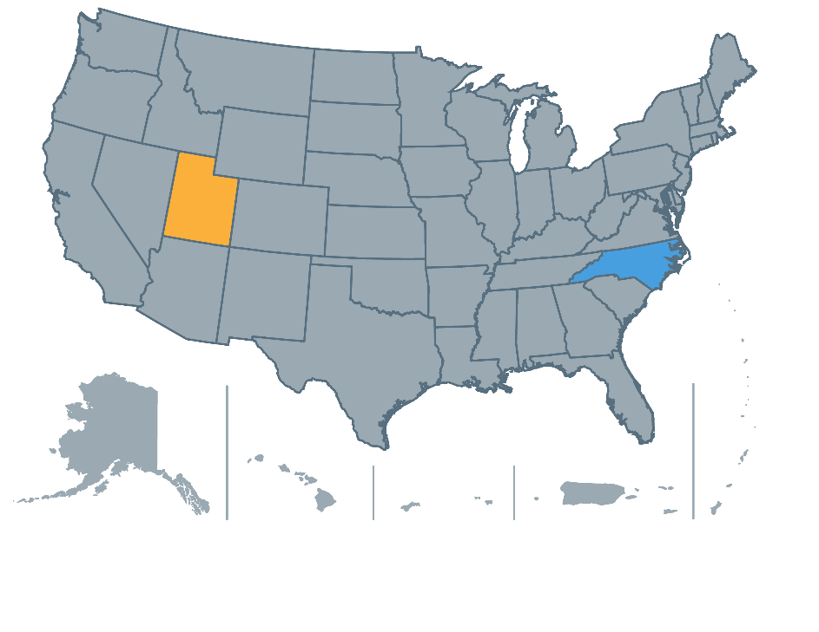
State Perspectives
Mike Jolley and Stephen Matherly, Utah Early Childhood
Hayley Young and Tanya Morgan, North Carolina Department of Health and Human Services
Please feel free to ask questions via the chat and we will answer them in between state presentations or at the end of the webinar.

Slide 17
Utah

Slide 18
Basic Considerations
Important to consider long-term goals and objectives
Inventory of systems and data
UID (Unique Identifier) and/or data matching
Decide on model Federated, Centralized, Hybrid or Other
Stakeholder user engagement is key
Documentation must be ongoing (live document)

Slide 19
Long-Term Goals and Objectives
Ensure confidentiality of protected data
Minimize impact on programs
Use cases drive what program data is needed in ECIDS
Report filters/design flexibility that meet stakeholder overall goals and objectives
Designed for extensibility, maintainability, scalability in incremental steps
Minimize development and ongoing operational costs
Utilize an iterative development lifecycle process
Maximize opportunities for stakeholder/user engagement

Slide 20
ECIDS Infrastructure Model
A Combination Model, not purely Hybrid, Federated or Centralized
Various types of connectivity (extracts, API, direct database) and program system capabilities
Utilize a different system (DOHMPI) for ETL and identity matching functionality:
Program data is federated
Demographic data is centralized
Utilize identity data matching
Contains de-identified data from programs (centralized)

Slide 21
Underlying Systems and Methodology
Standard Reports
Analysis Reports
Engagement
Reports
Program /DS
Program / DS
Programs
UDOH DOHMPI
ECIDS
UDRC (SLDS)
This software system is not part of the ECIDS project.
ECIDS
Keep DOHMPI focused on identity matching, extraction, translation and exchange
Keep ECIDS focused on providing data analytics and research tools for longitudinal studies

Slide 22
Overall ECIDS Infrastructure Vision
Standard Reports:
Early Intervention
Head Start
Home Visiting
Child Care
Ages & Stages Questionnaire
WIC
ECIDS
Registries
Data Analytics & Engagement Reports:
Birth Certificate
Death Certificate
...

Slide 23
Overall ECIDS Infrastructure Vision (continued)
Early Childhood Programs
Early Intervention
Head Start
Home Visiting
Child Care
Ages & Stages Questionnaire
WIC
Other Longitudinal Data Systems
ECIDS
Registries
Birth Certificate
Death Certificate
...
UDRC (SLDS)

Slide 24
De-Identifiable Data Warehouse
Address privacy concerns
Keep identifiable program data separated (federated)
Use a different system for identity matching
Pull de-identifiable data directly from federated program(s) data
Require credentials to access ECIDS data
Lower barriers for stakeholder willingness to participate

Slide 25
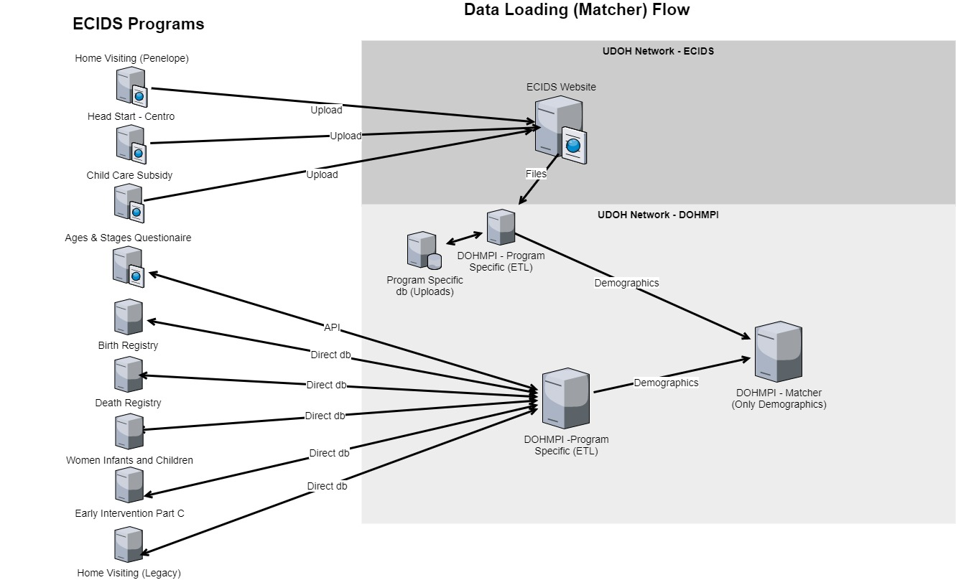
Data Loading (Matcher) Flow

Slide 26
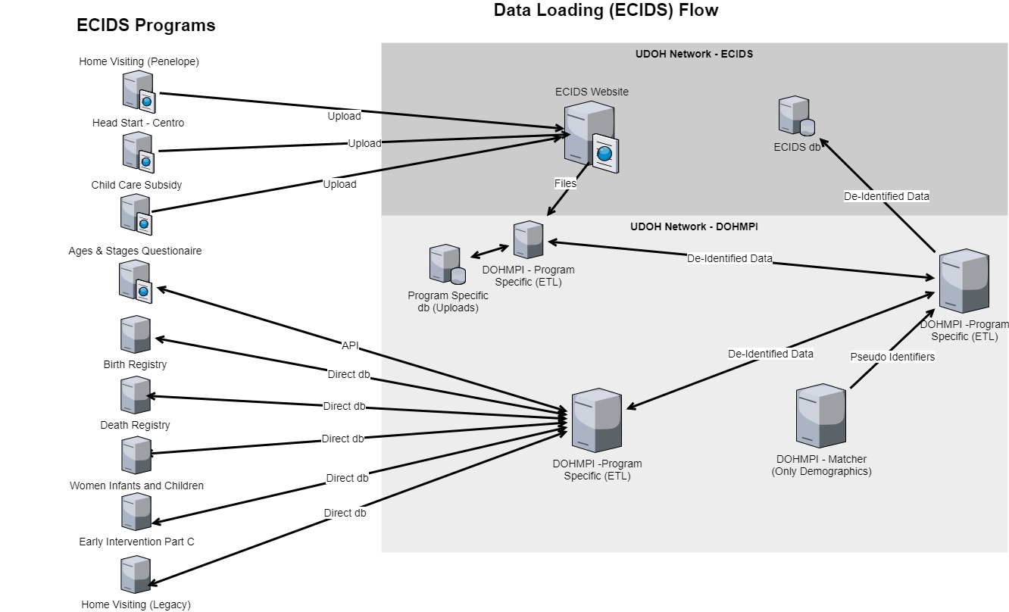
Data Loading (ECIDS) Flow

Slide 27
Data User (ECIDS) Flow

Slide 28
Challenges and Lessons Learned
Data Governance
Stakeholder education and engagement
Changing stakeholder key contacts
On-going development funding
Prioritizing project initiatives
Internal consolidation dynamics
Data and Program System Challenges
Identify, review, document, and management issues
Child level data
Mapping problems
Data granularity dynamics
Timing context as it relates to addresses
Subtle semantic differences (e.g., race)
Data quality

Slide 29
What Can We Do Now? Population Data
Community Assessment Tool (CAT) – Population Reports
Population Eligibility: Child population data and household composition
Eligibility Risk Factors: Child population by age, child risk factors and living in poverty, mother’s risk factors at birth
Access - Provider Counts: Provider counts by service category and region
Access - Capacity: Child-care slots and vacancy by age group
Impact: Utah’s Preschool Entry and Exit Profile (PEEP), Utah’s Kindergarten Entry and Exit Profile (KEEP) and Utah education scorecard

Slide 30
What Can We Do Now? ECIDS Child Data
Integrated Early Childhood and Registry Identity de-identifiable (birth month/year, zip code) data and pseudo identifiers
Integrated Early Childhood enrollment data
Integrated Early Childhood class attendance and home visit data
Standard Reports
ECIDS Report #1: Child counts within a program and child counts across programs (distinct)
ECIDS Report #2: Children enrolled/not enrolled, children in a single and multiple programs, newly/previously enrolled
ECIDS Report #3: Distinct children counts being served in multiple programs
ECIDS Report #4: Child program enrollment sequence patterns

Slide 31
What Can We Do Now? ECIDS Child Data (cont.)
Ages and Stages Questionnaire (ASQ) Screening Reports
ASQ Report #1: Overall and Program specific ASQ screening counts and overall results by age intervals
ASQ Report #2: Distinct children having ASQ screening by multiple ASQ programs
ASQ Report #3: Child counts in a single and multiple ASQ Programs

Slide 32
Next Steps
Limited annual ECIDS reports on the CAT (nearly ready)
Advanced Reports (nearly ready)
Engagement Reports
Program Class Attendance and Home Visits (currently developing)
Ages and Stages Questionnaire Research Reports/Extracts
Cohort Research Reports/Extracts
Additional Data From Existing Programs
Additional Birth Registry data
Eligibility data
Additional screening data
ECIDS Integration of Additional Programs
Finish integrating remaining Head Start Programs
Additional Registries (Immunization, Hearing, Newborn Blood)
Additional Early Childhood Programs
Payers

Slide 33
Questions?
Please type your additional questions for the panelists into the chat.

Slide 34
NC ECIDS System Infrastructure
North Carolina Department of Health and Human Services

Slide 35
History of ECIDS
NC ECIDS is the single source for integrated early childhood data for selected education, health, and social services programs to help answer key policy and program questions.
It was originally funded by the state through a federal Race to the Top – Early Learning Challenge grant and is now maintained by the North Carolina Department of Health and Human Services. The North Carolina Department of Information Technology provides technology management for NC ECIDS. The NC ECIDS Governance Council sets policies for NC ECIDS operation and provides feedback to inform the development of the NC ECIDS data application, web portal, and workflow processes.
NC ECIDS has a dedicated, private data request portal for research data requests.

Slide 36
Mission and Vision
Mission
Maintain and enhance a high-quality, comprehensive, integrated early childhood data system for North Carolina to inform policies and practices that produce better outcomes for children and families.
Vision
To maintain a high-quality early childhood integrated data system (ECIDS) for North Carolina (NC) that is in support of state priorities to improve early childhood and later life outcomes, particularly for the most vulnerable children. The NC ECIDS will be readily accessible and relevant for use by state and local agencies, policy makers, program and community leaders, researchers, community leaders, and advocacy groups to make data-informed decisions in a way that fosters data responsibility and integrity.

Slide 37
NC ECIDS Goal
We believe early childhood integrated data will lead to:

Slide 38
NC ECIDS Promise
We take our mission seriously and recognize the sensitivity around the data we integrate and place in reports. Accordingly, NC ECIDS fully commits to the following:
NC ECIDS will not ...
NC ECIDS will ...
Integrate data in order to answer key program and policy questions Provide counts of children who receive multiple early childhood services Produce aggregate reports for common program & policy questions Provide data elements for approved research requests Include only children who are receiving services from participating programs (not every child in NC) | Evaluate or track individual children, teachers, centers, or schools Release names, SSNs, addresses, pictures, or client children and parents Give access to data without a thorough review of each request or without a clear and demonstratable need to know Allow use of data without strict guidelines and terms in place for the proper handling of and disposal of data

Slide 39
What Can We Do Now?
Integrate early childhood data across programs
Provide distinct counts of which children are being served
Link data to answer questions that currently cannot be answered (e.g., Part C and Part B)
Let researchers request data to answer key policy and program questions

Slide 40
Updates to ECIDS

Slide 41
Preschool Development Grant Initiatives
North Carolina received funding to modernize and expand NC ECIDS.
Several projects are already underway or will get underway in the near future:
Continued work to modernize the NC ECIDS reporting and request platforms
Expanded reports and reporting functionality for internal NC ECIDS teams and the public to leverage
Expanded work to integrate home visiting data into NC ECIDS
Expanded work to integrate Head Start data into NC ECIDS
Integration of data from North Carolina’s Early Hearing Detection and Intervention (EHDI) program into NC ECIDS
Additional project management resource to manage new PDG activities for NC ECIDS

Slide 42
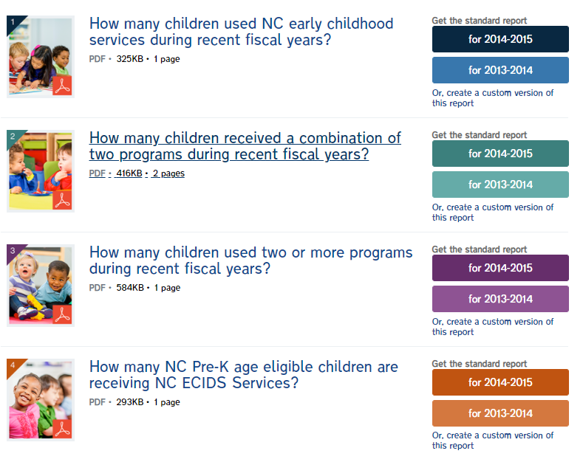
NC ECIDS Reports
Four reports are currently available:
Total and Unduplicated Number by NC ECIDS Service. How many children used North Carolina early childhood services during recent fiscal years?
Number of Children Receiving Multiple NC ECIDS Services. How many children received a combination of two programs during recent fiscal years?
Number of Children Receiving Two NC ECIDS Services. How many children used two or more programs during fiscal years?
Number of NC Pre-K Age Eligible Children Receiving NC ECIDS Services. How many North Carolina prekindergarten-age eligible children are receiving NC ECIDS services?

Slide 43
Current NC ECIDS
Signed memorandum of understanding (MOU) in April 2021 for additional Preschool Development Grant work
Collaborating with NC ECIDS programs and technology partners to add updated data to existing NC ECIDS reports, which are currently only publicly available with data through 2014-15
Developing new NC ECIDS website
Reviewing MOUs and other contracts and legal documents
Validating program data in NC ECIDS
Data from education, health, and social services programs:
North Carolina prekindergarten
Subsidized Child Care (SCC)
Infant Toddler Program – Early Intervention (IDEA Part C)
Special Education (IDEA Part B 619)
Food & Nutrition Services (FNS)
Child Protective Services (CPS)
Temporary Assistance for Needy Families (TANF)

Slide 44
Future NC ECIDS
Data Selector Tool
Data Selector User Interface with expanded functionality for submitting, processing, and managing internal and external data requests
New ECIDS research request external web application
Integrate data from early education and health programs
NC Head Start
Home Visiting
Early Hearing Detection and Intervention (EHDI)
Incorporate data into the statewide longitudinal data system
Data enhancements
Increase frequency for integrating data sources from annual to monthly basis
Modernize NC ECIDS data

Slide 45
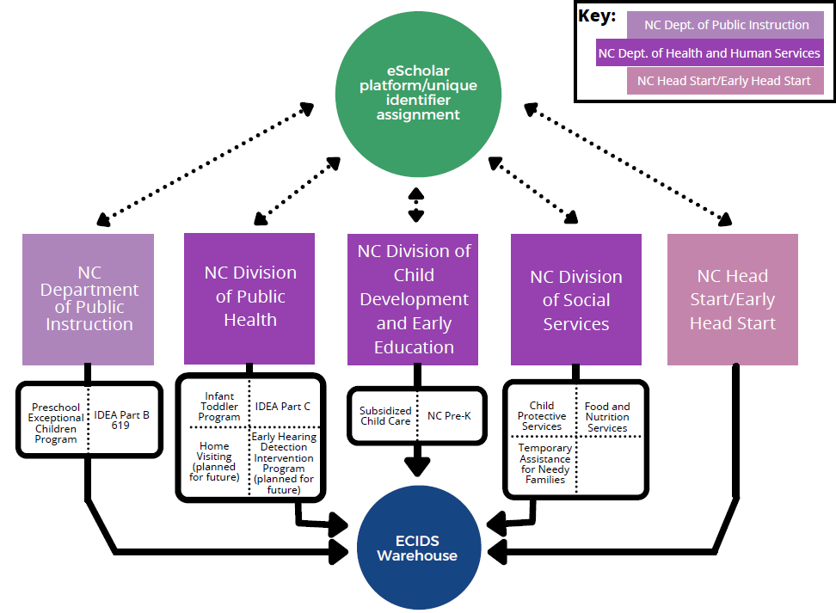
ECIDS Infrastructure

Slide 46
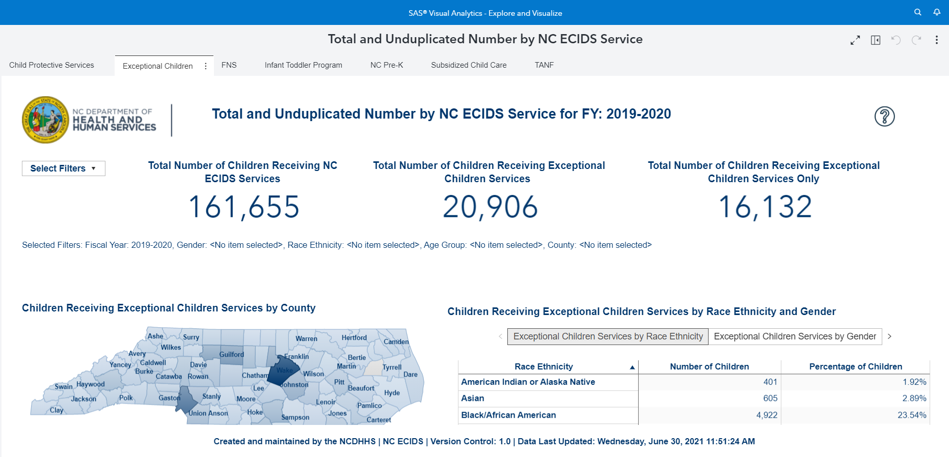
NC ECIDS Report
Added new data sources to the Data Selector tool

Slide 47
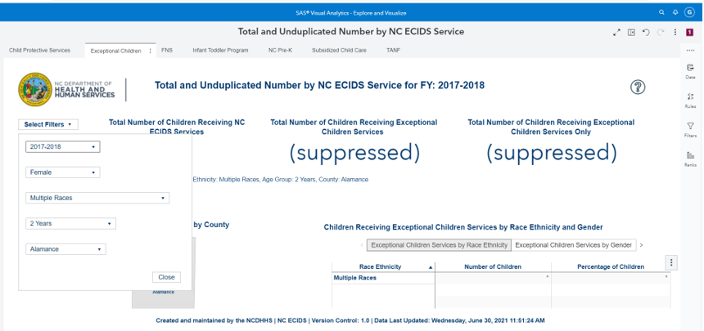
NC ECIDS Report: Data Filter
Multiple ways to slice data by fiscal year, gender, race/ethnicity, age, and county

Slide 48
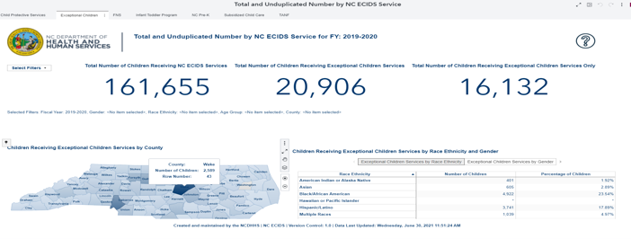
NC ECIDS Report: County-Level Data
The reports are interactive and use color to show high to low values and display county-level data.

Slide 49
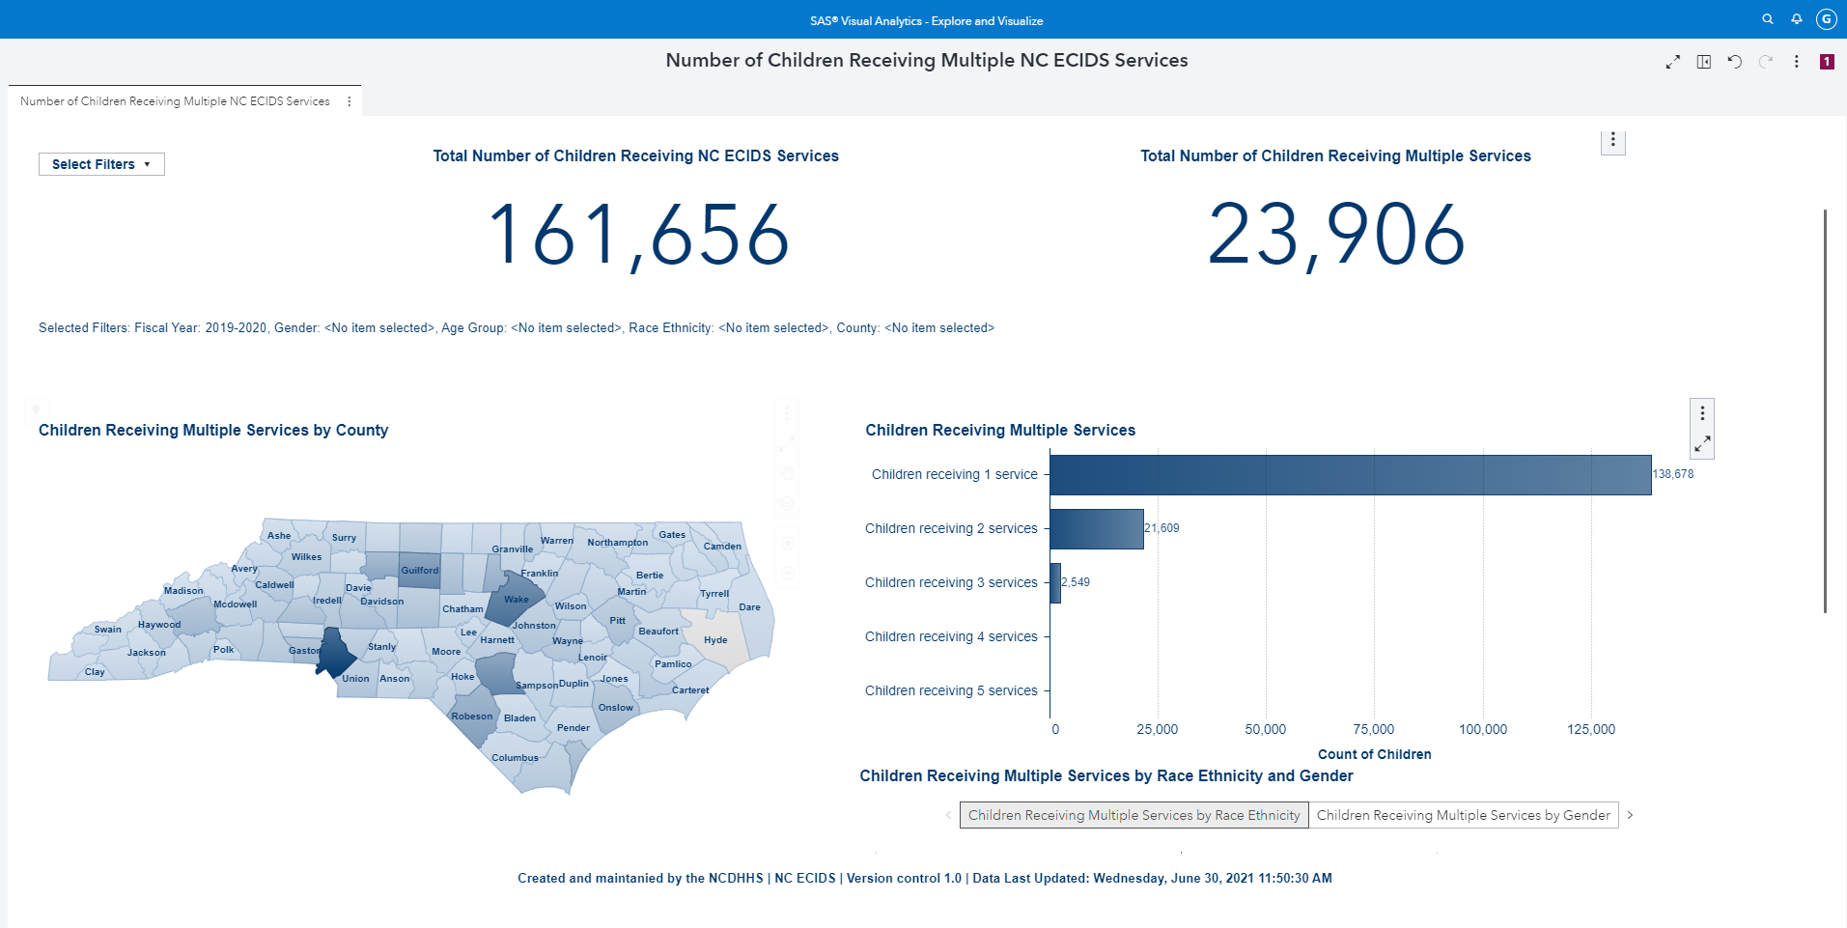
NC ECIDS Report: Grouped by Number of Services Required
This report displays number of children receiving multiple NC ECIDS services.

Slide 50
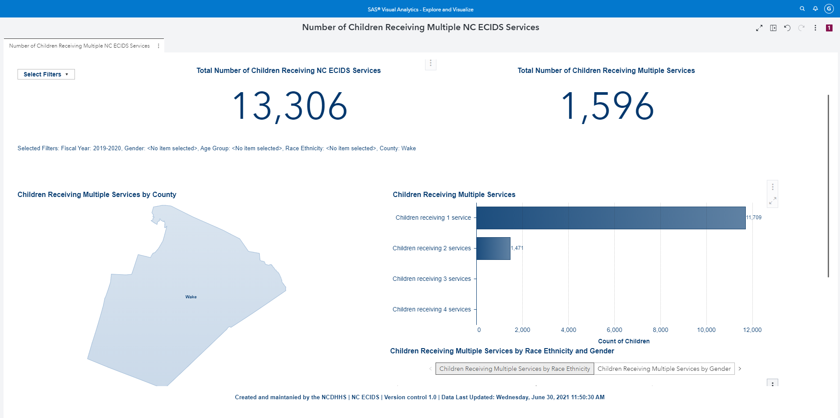
NC ECIDS Report: County Level
This report displays number of children receiving multiple NC ECIDS services at the county level.

Slide 51
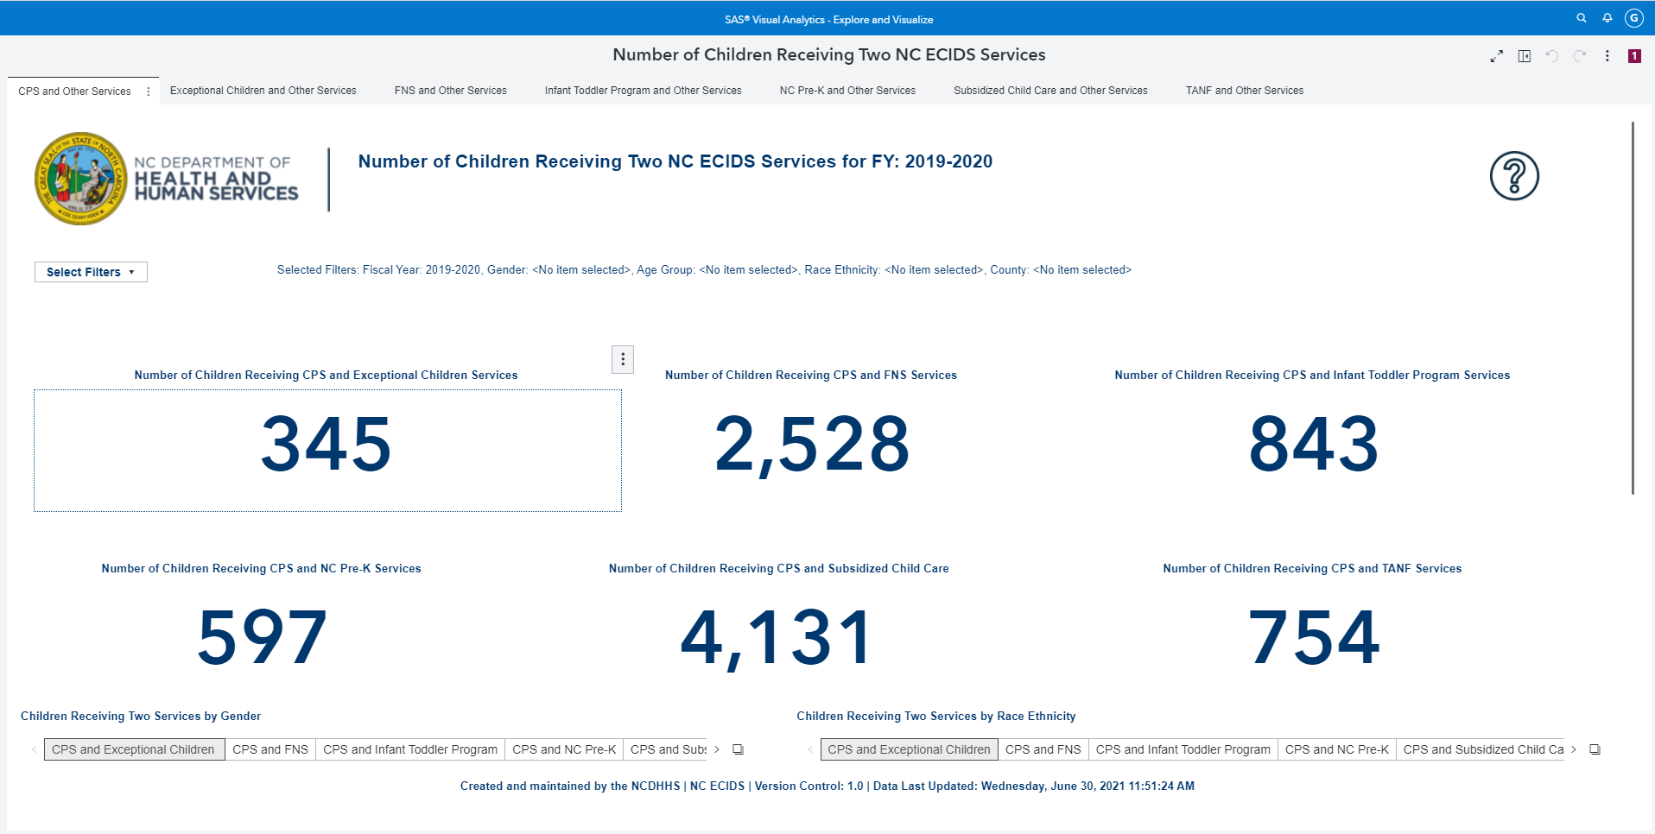
NC ECIDS Report: Number of Children
This report displays number of children receiving two NC ECIDS services.

Slide 52
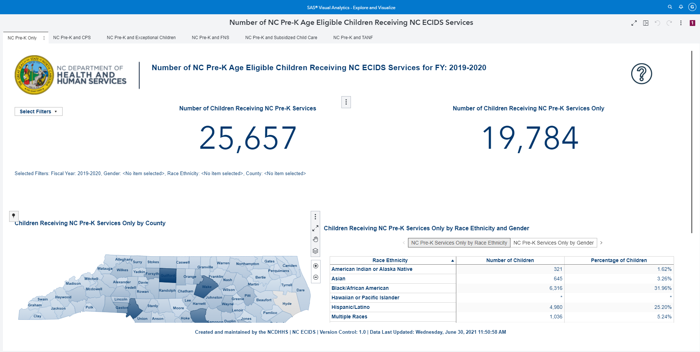
NC ECIDS Report: By Race
This report displays number of North Carolina prekindergarten age eligible children receiving NC ECIDS services by race.

Slide 53
Questions?
Please type your additional questions for the panelists into the chat.

Slide 54
New from the SLDS State Support Team: Updated ECIDS Toolkit
https://slds.ed.gov/#program/ecids-toolkit

Slide 55
What’s Different?
New navigation and other user interface features
Revised, downloadable ECIDS guides and self-assessments for all 7 SLDS Framework components
Updated resources for each SLDS Framework component

Slide 56
Resources
Utah
Early Childhood Integrated Data System, https://ecids.utah.gov/
Early Childhood Utah, https://earlychildhoodutah.utah.gov/
Maternal and Child Health Bureau, https://health.utah.gov/mch/
Utah Department of Health, https://health.utah.gov/
North Carolina
North Carolina Early Childhood Integrated Data System, https://www.ncdhhs.gov/north-carolina-early-childhood-integrated-data-system
NCDHHS – Division of Child Development and Early Education, https://ncchildcare.ncdhhs.gov/

Slide 57
Contacts
Presenter Contact Information:
Stephen Matherly, Utah, smather@utah.gov
Mike Jolley, Utah, mike.jolley@mdsc.com
Hayley Young, North Carolina, hayley.young@dhhs.nc.gov
Tanya Morgan, North Carolina, tanya.morgan@dhhs.nc.gov
Amy Nicholas, SLDS State Support Team, amy.nicholas@sst-slds.org
Jeff Sellers, SLDS State Support Team, jeff.sellers@sst-slds.org
For more info about the SLDS State Support Team or to request support:
SLDS Communities360 website, http://slds.ed.gov
Contact your state’s SST Point of Contact for assistance: https://slds.ed.gov/#communities/pdc/documents/14522

Slide 58
Thank you!

